Slide 1

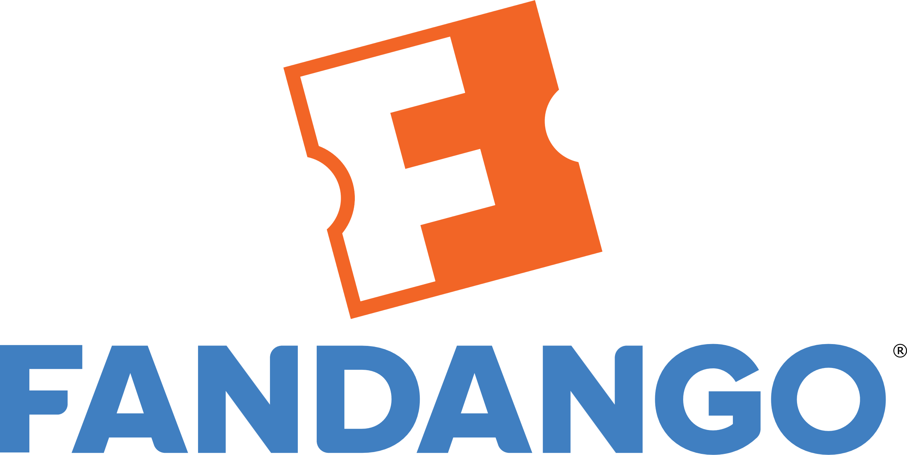
TERM PROJECT

Slide 2
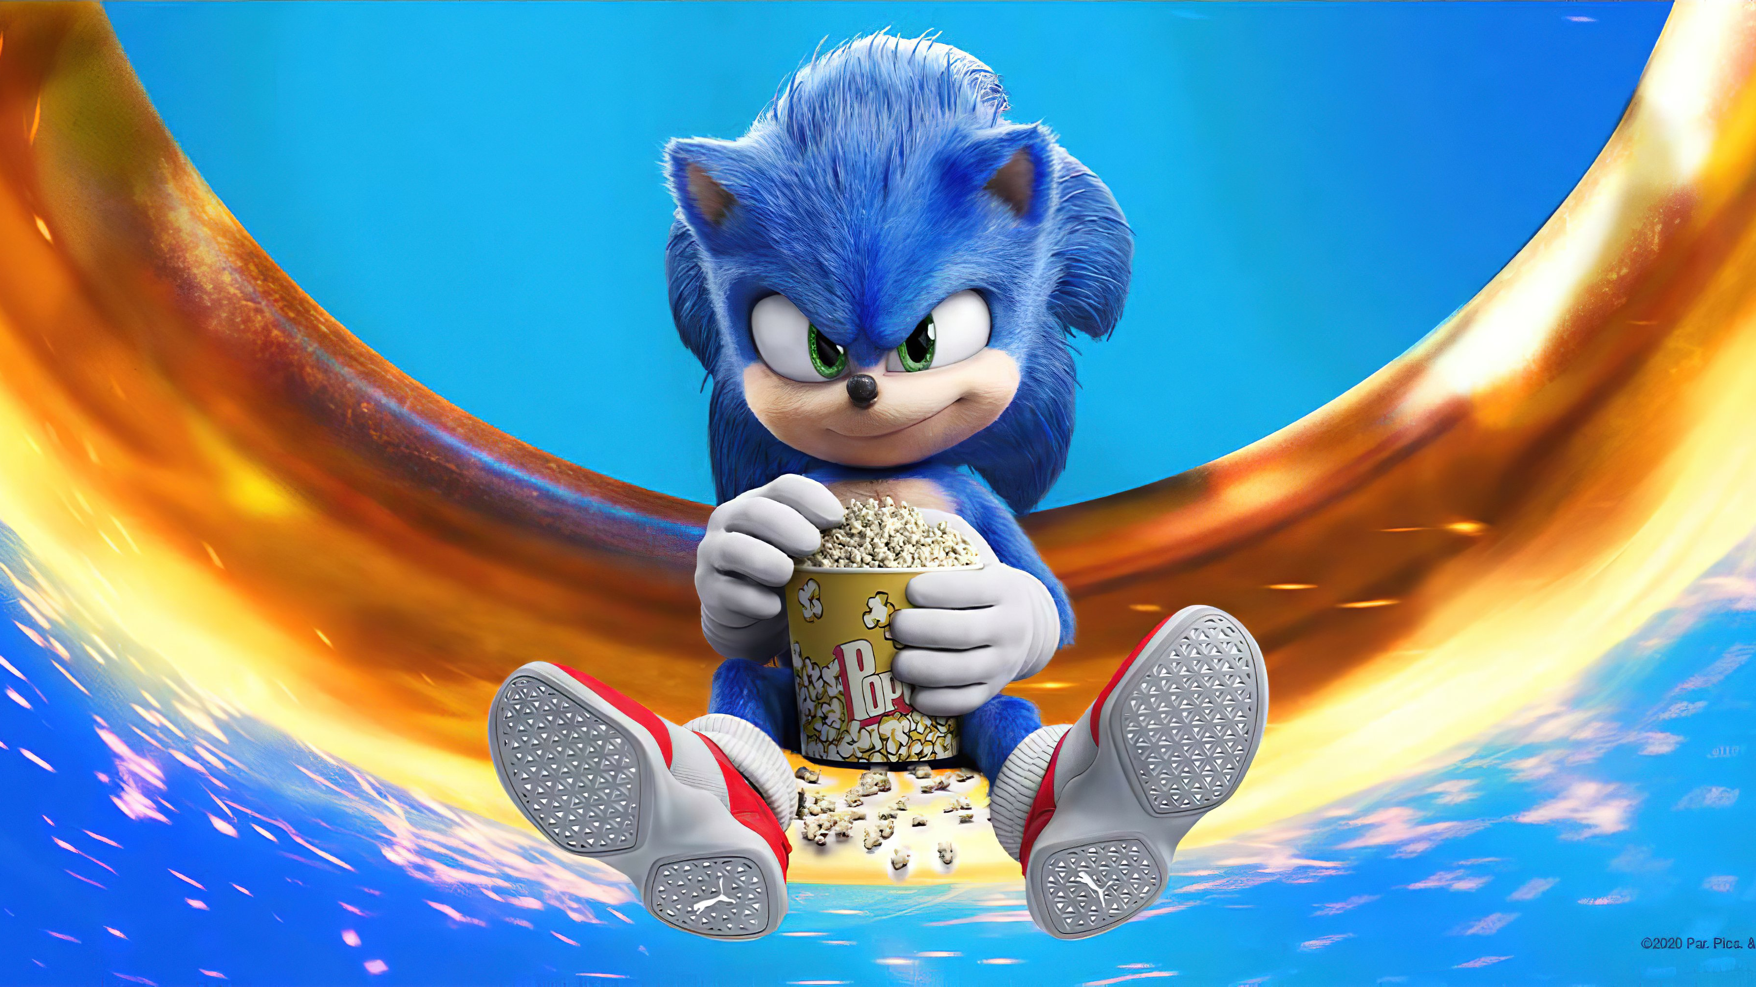
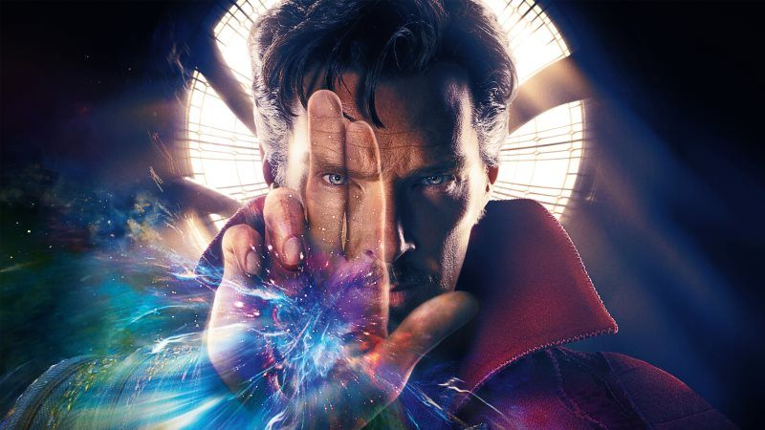
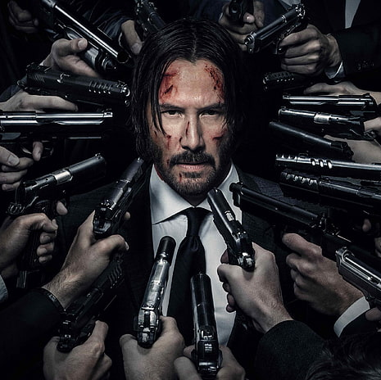
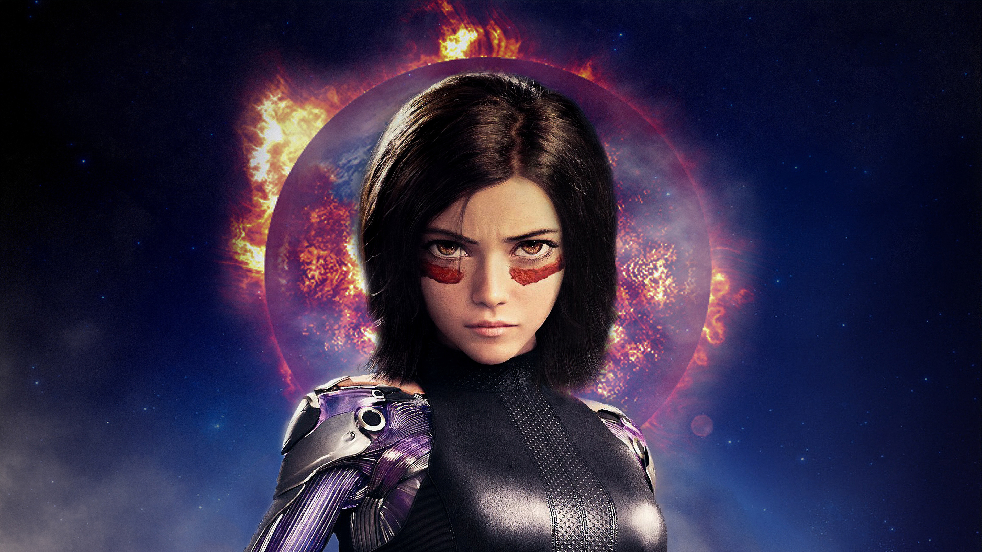
Contents
Team Structure
Purpose of the Test
Scope of the Test
Heuristics List
Heuristic Evaluation and Recommendations

Slide 3

1.TEAM STRUCTURE
PAUL YANOVER-PRESIDENT FANDANGO
KEVIN SHEPELA-EXECUTIVE VICE PRESIDENT, CHIEF COMMERCIAL OFFICER
DANA BENSON-SENIOR VICE PRESIDENT, COMMUNICATIONS
ERIC BLACK-SENIOR VICE PRESIDENT, TECHNOLOGY
JASON DAVIS-SENIOR VICE PRESIDENT & GM, REWARDS & GIFT CARDS
KERRY SAMOVAR-SENIOR VICE PRESIDENT, HEAD OF BUSINESS & LEGAL AFFAIRS
MARK YOUNG-SVP, GLOBAL STRATEGY, BUSINESS & CORPORATE DEVELOPMENT
ALEJANDRA BRIZUELA-VP, PRODUCT AND UX/DESIGN
JOHN ORSANIC-VP, HEAD OF FINANCE
JOSETTE SPROTT-VP, HUMAN RESOURCES

Slide 4
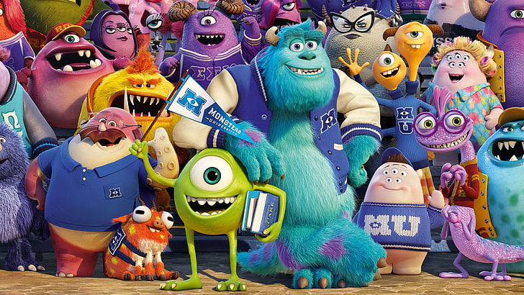
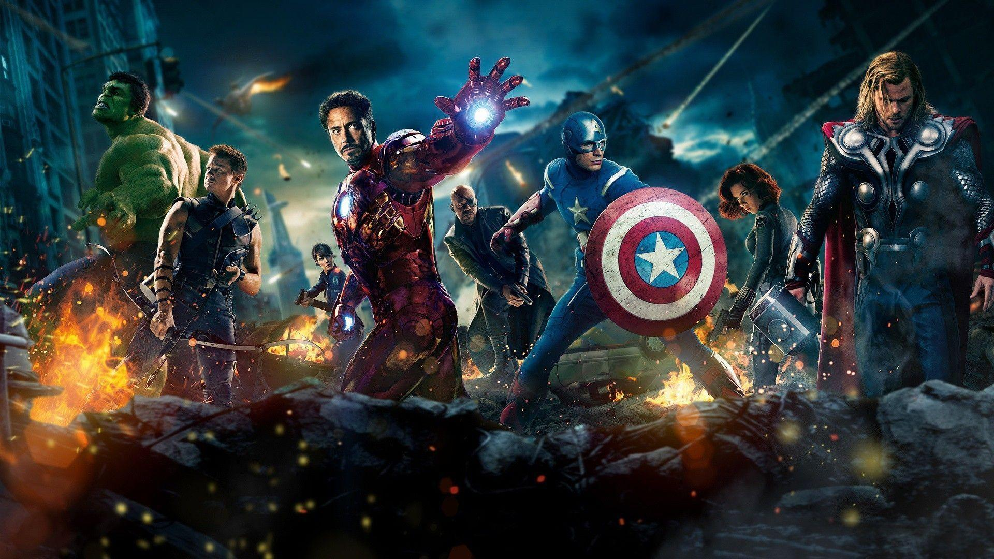
2. Purpose of the Test

Slide 5
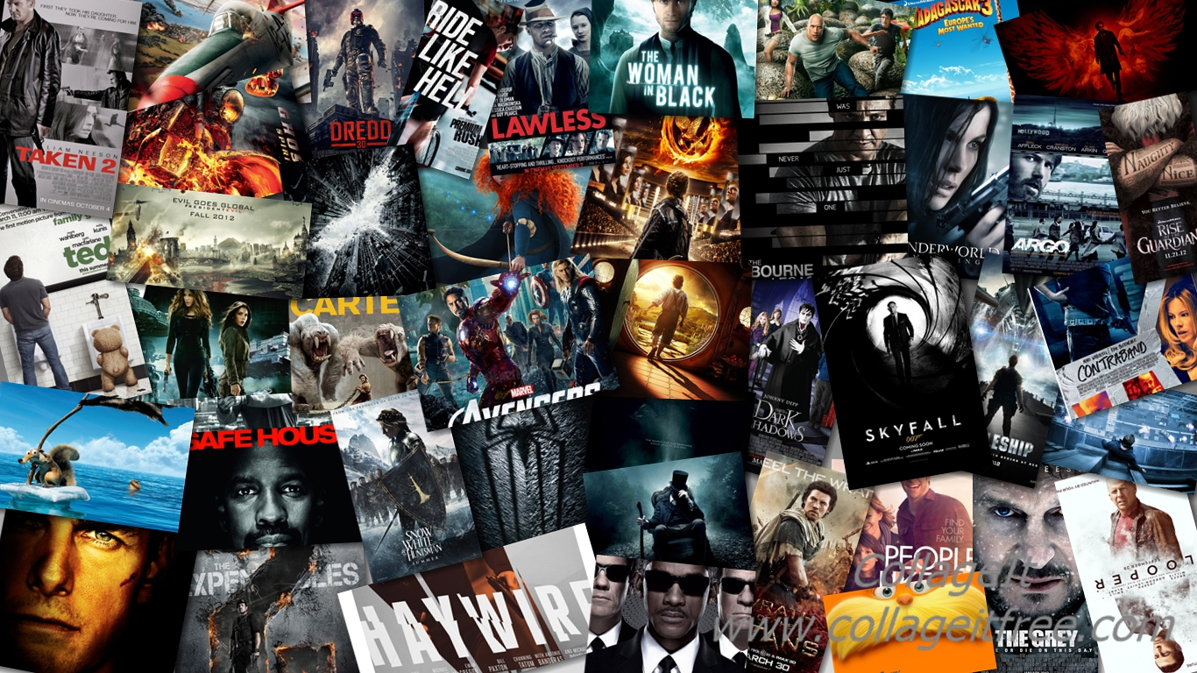
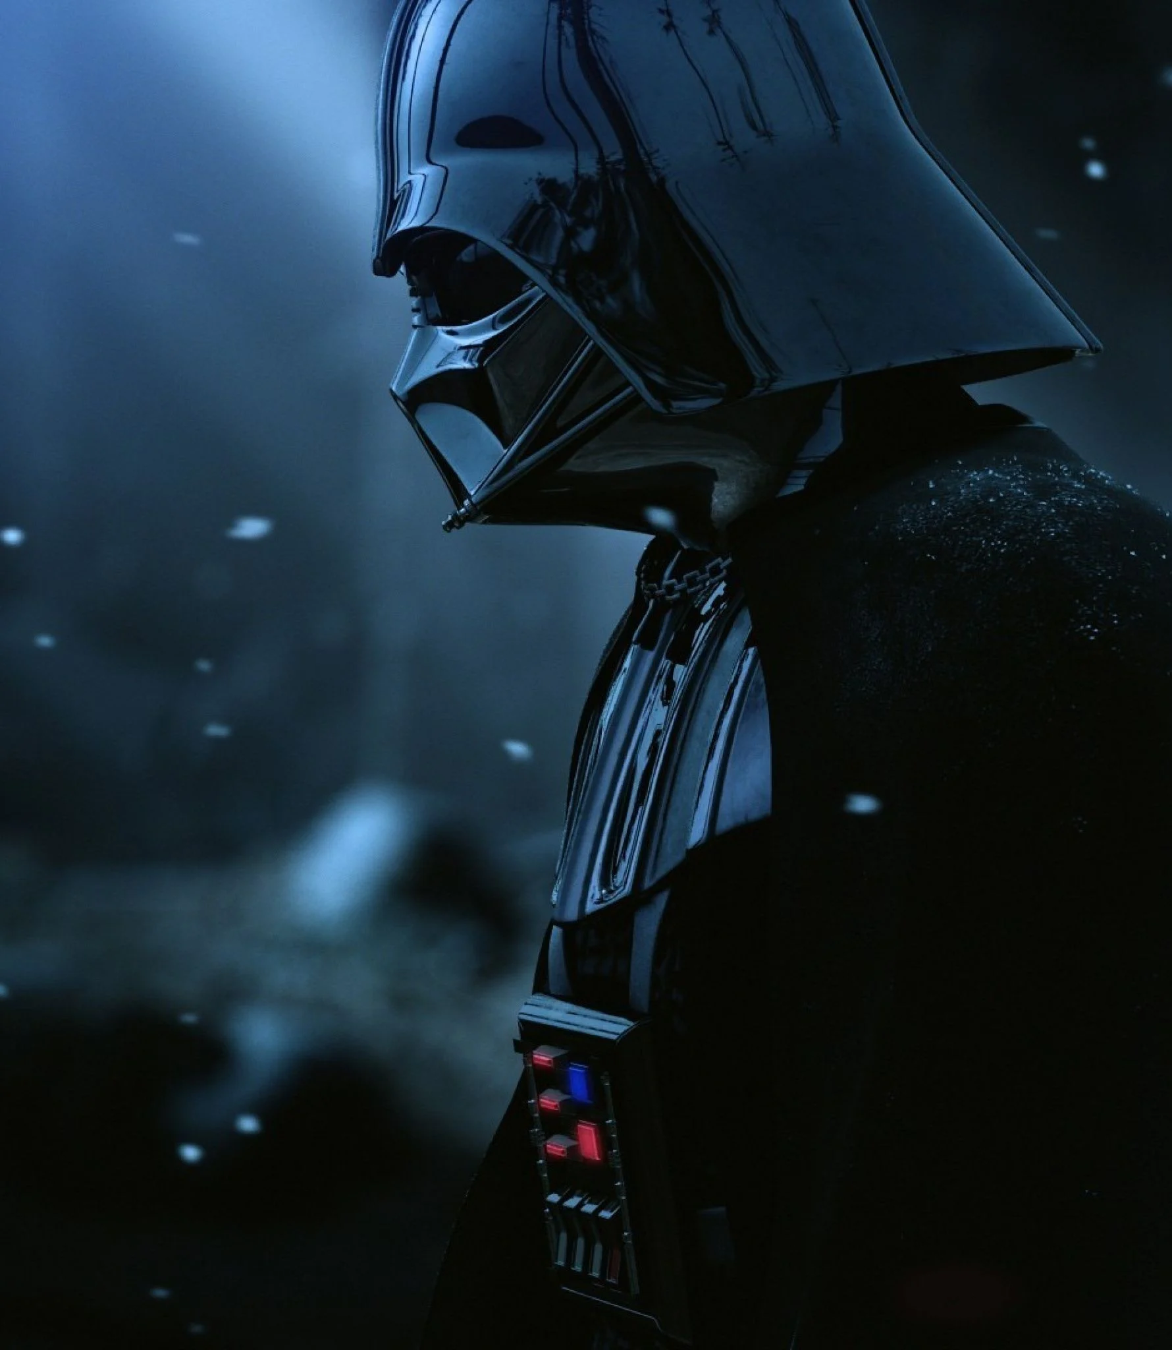
2.1. Our Purpose
My mother thinks we've loved hearing and telling stories since we were little. So, we chose to put ourselves in the position of the hero, to examine things from our own perspective, and to identify with his life. So, the fact that the stories of the movies were beautiful made us select to watch the movie. Watching movies has become a part of our lives over time. So, we decided to go over a movie site. What should be the most user-friendly, most effective movie site? We left with the question. In this respect, we have decided to evaluate the Fandango platform. In our presentation we are going to talk about the heuristic evaluation of the platform.

Slide 6
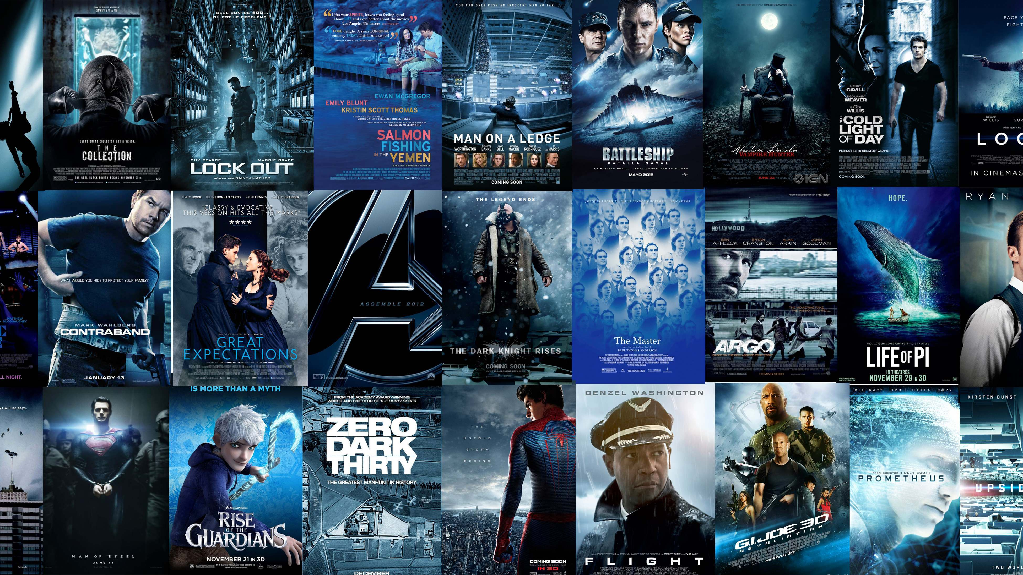

2.2.What is the Fandango.com?
Fandango is the ultimate digital network for all things movies and TV, serving more than 50 million unique visitors per month, according to comScore, with best-in-class movie and TV information, movie ticketing, trailers and original video, and home entertainment. Its portfolio features leading online ticketers Fandango, MovieTickets.com and Flixster; world-renowned entertainment review site Rotten Tomatoes; and Movieclips, the #1 movie trailers and content channel on YouTube. Fandango's on-demand streaming service, Vudu, offers over 200,000 new release and catalog movies and next-day TV shows to more than 200 million connected, over-the-top (OTT) and mobile devices.

Slide 7
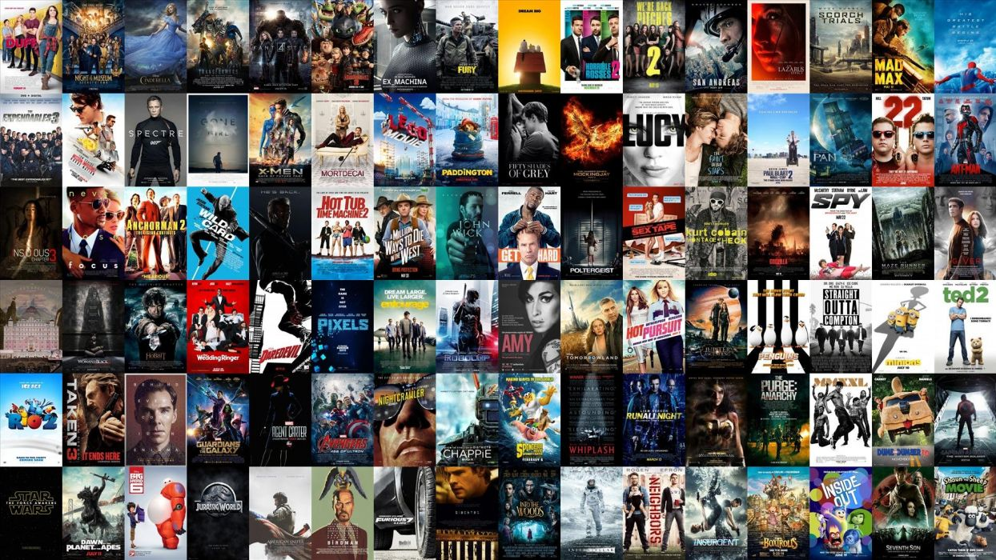

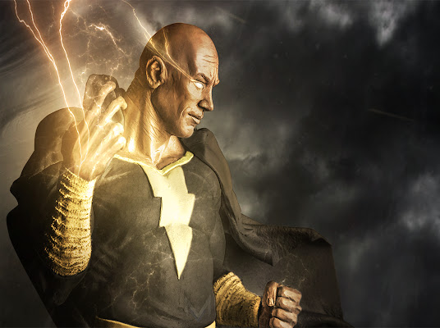


2.3.Who are the current/potential users of the platform?
Fandango provides facility for users who want to buy movie tickets, find movie release date, watch trailers, read movie reviews and more. It can be used by anyone who has basic computer knowledge and likes watching movies. Moreover, users who is older than 18 can buy tickets for movies.

Slide 8
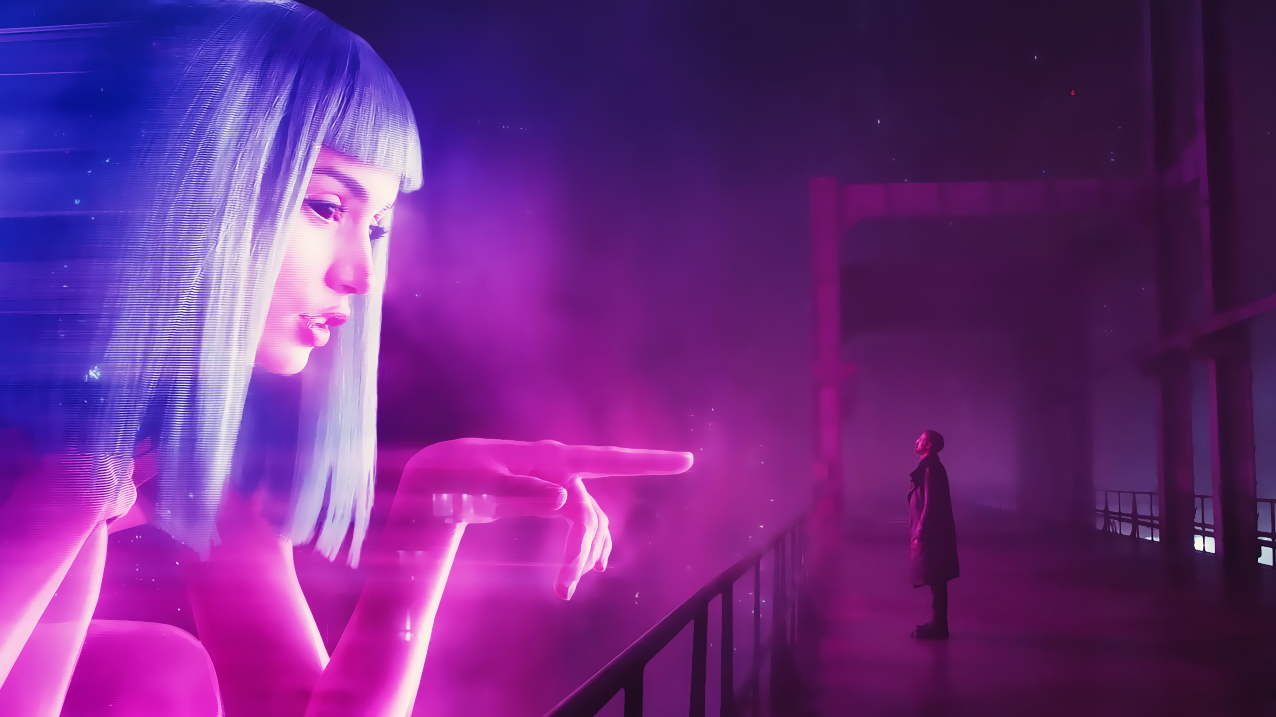
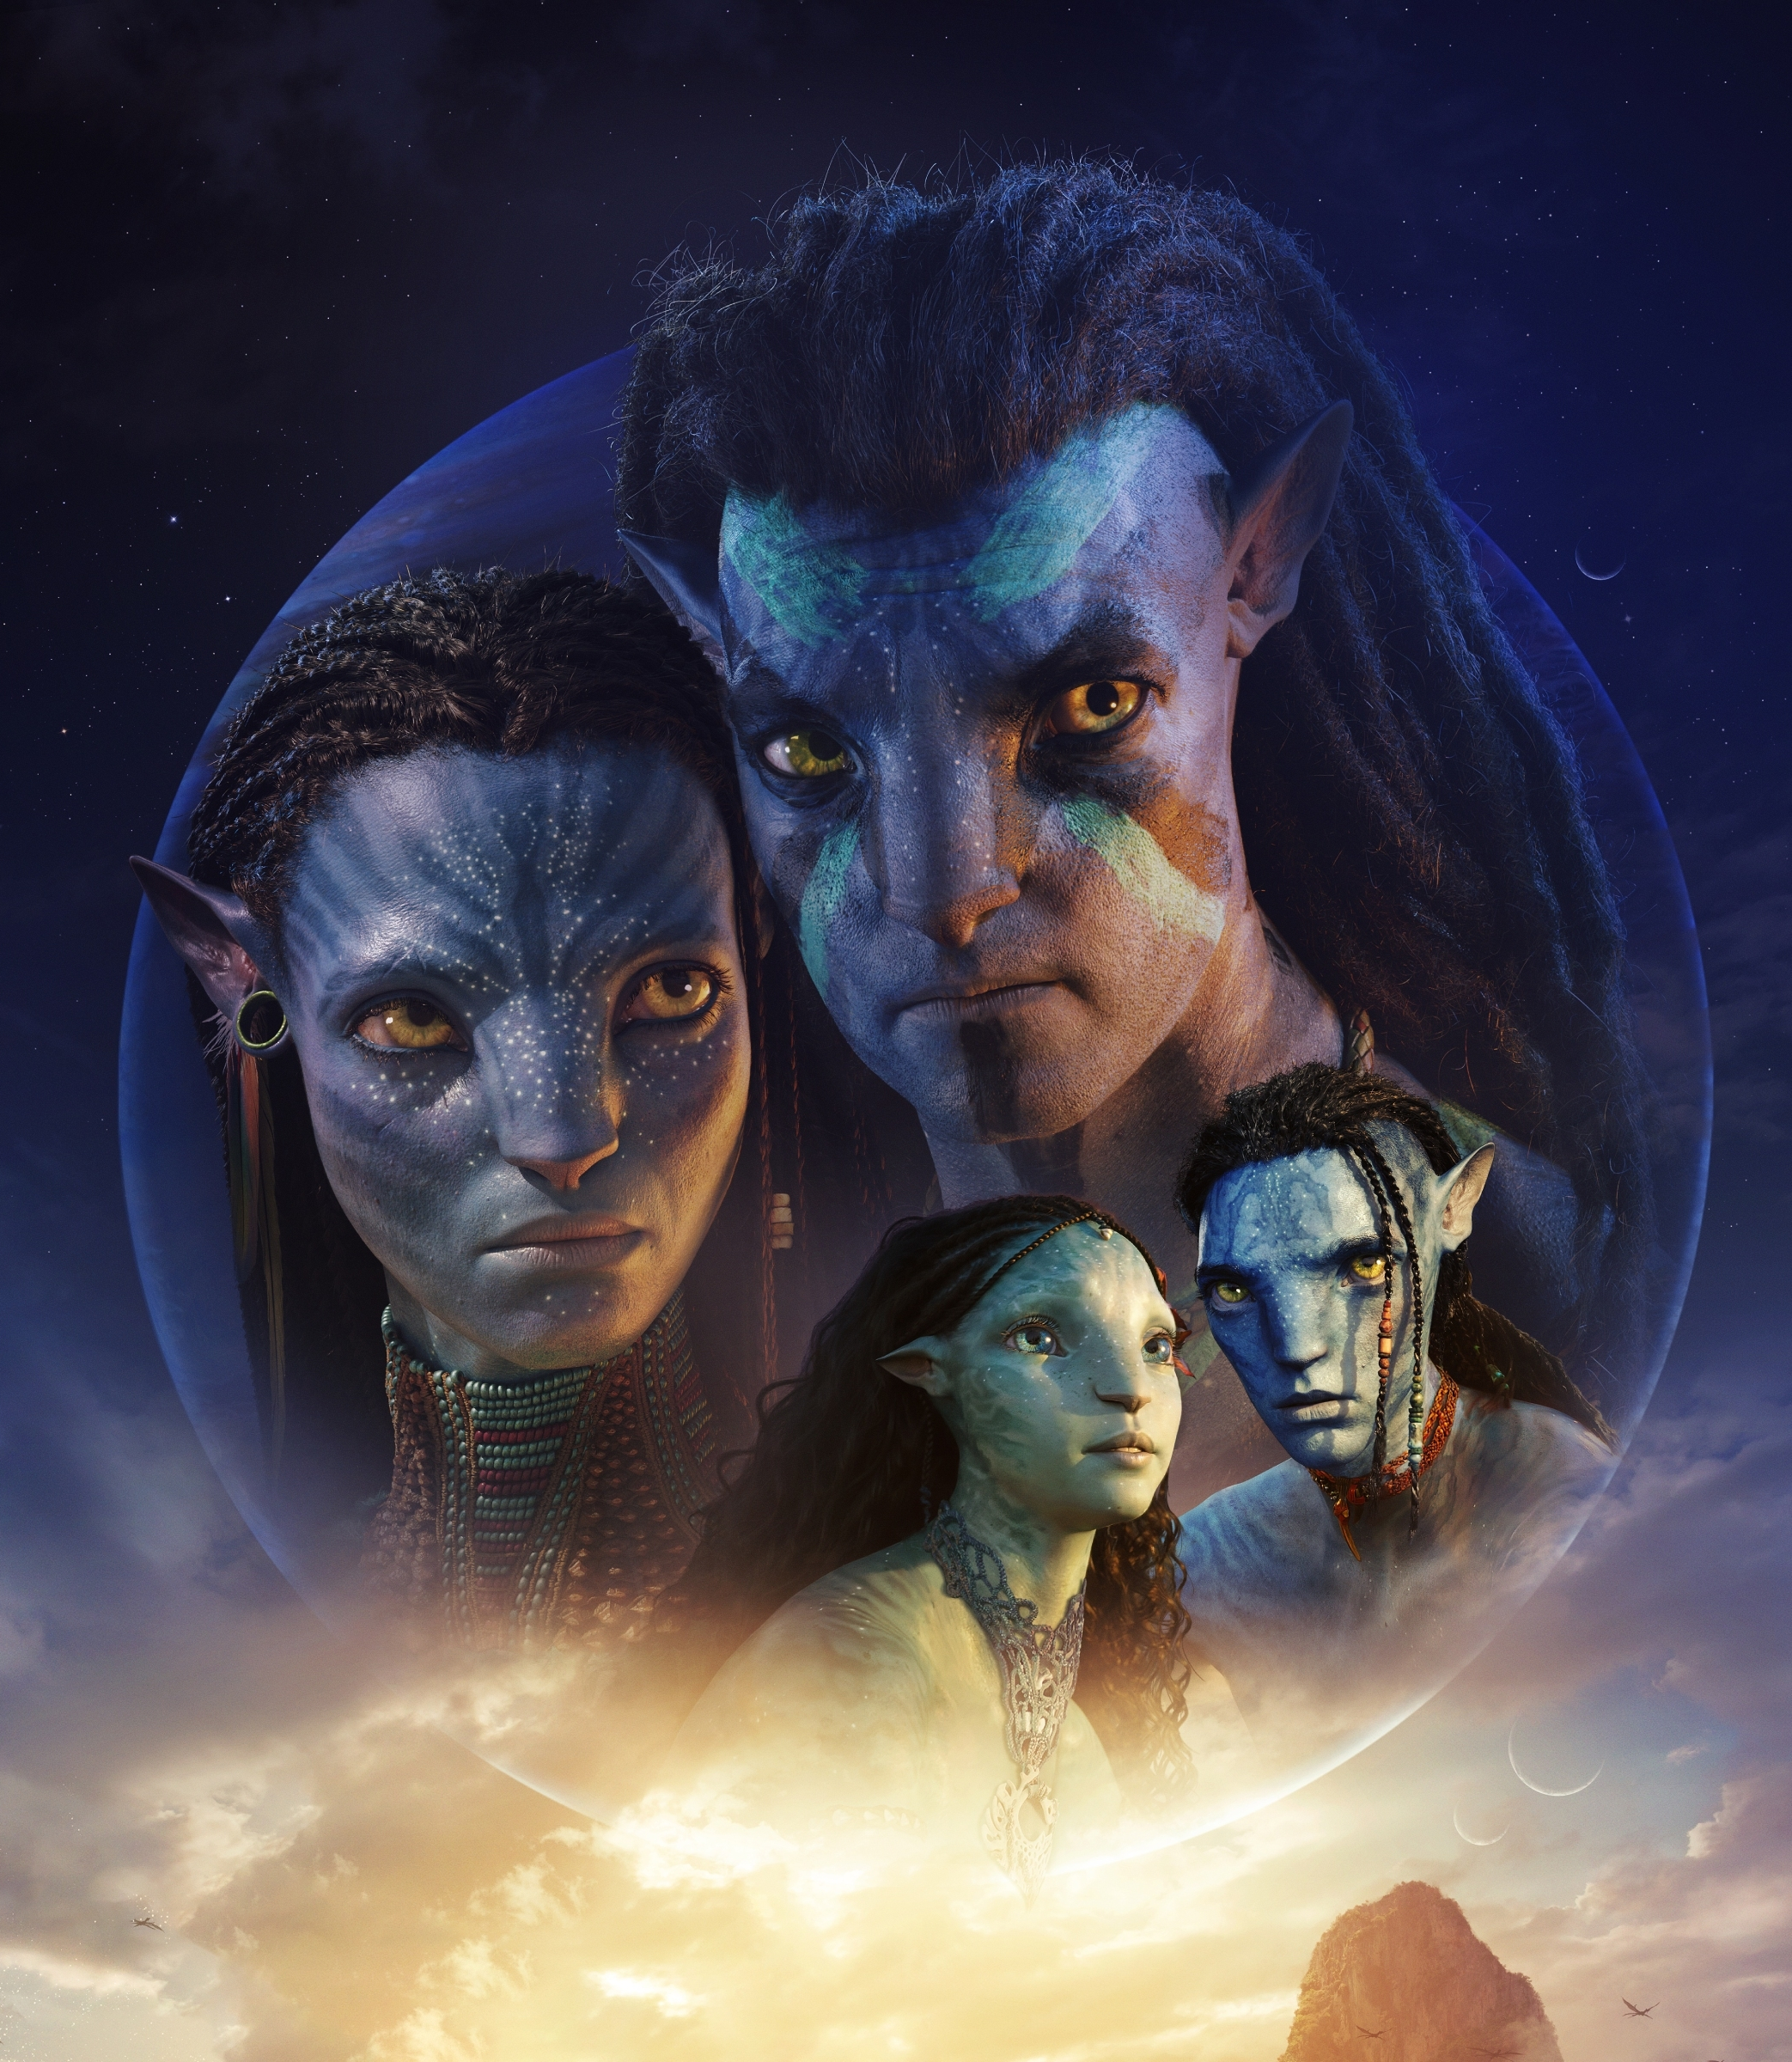
3.Scope of the Test

Slide 9
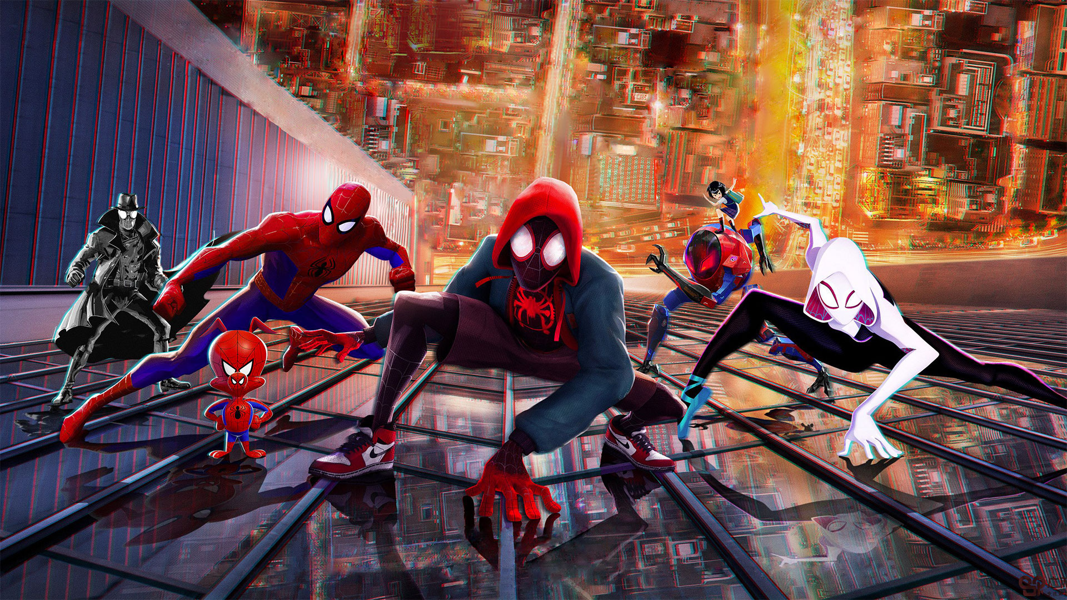
First impression is always very important, so we chose Sign-In and Sign-Up pages firstly. Sign-In and Sign-Up pages are pages that every user opens in order to use the website actively. Often on these pages, users begin to get their first impression of the quality of the website. That's why the designs of these pages are so important.
Secondly, we chose the account page. Because the account page is a page that should be given great importance to security, clarity and simplicity, as users can change account details, past orders and site settings. The design of this page should be designed to allow users to perform transactions quickly.
Thirdly, we chose the main page. Because the main page is the first page that welcomes the user after logging into the system, and users spend a lot of time here. This page should be well designed.
Finally, we chose the page where the movie-actor details are displayed. Because, before going to the movie, a user wants to see the details of the movie and the actors of the movie. The design of this page is very important for ticket sales. Therefore, this page should be simple and useful.

Slide 10
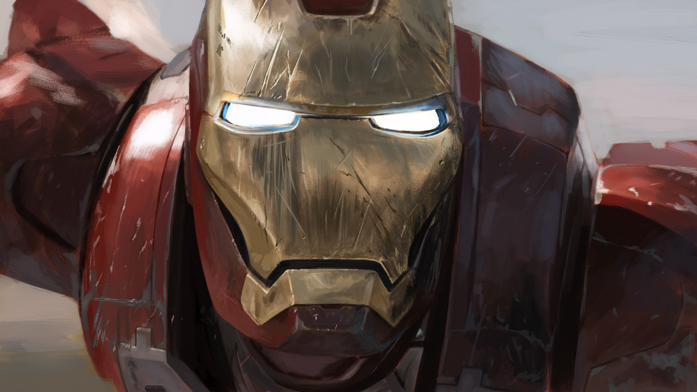
4. Heuristics List

Slide 11
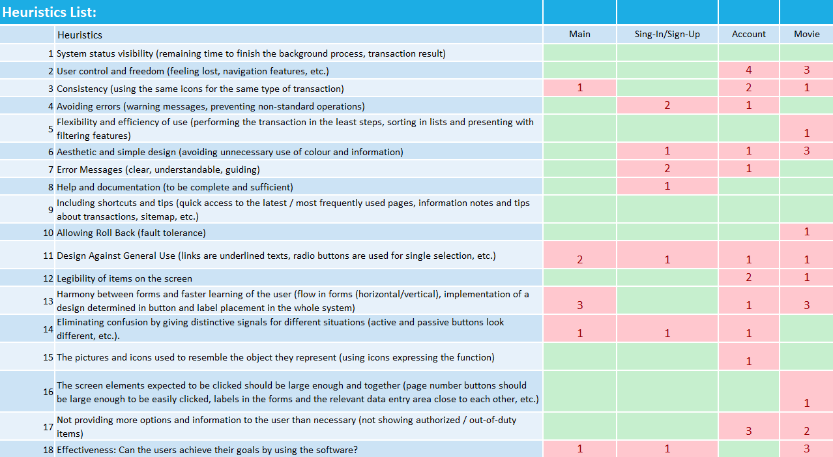

Slide 12
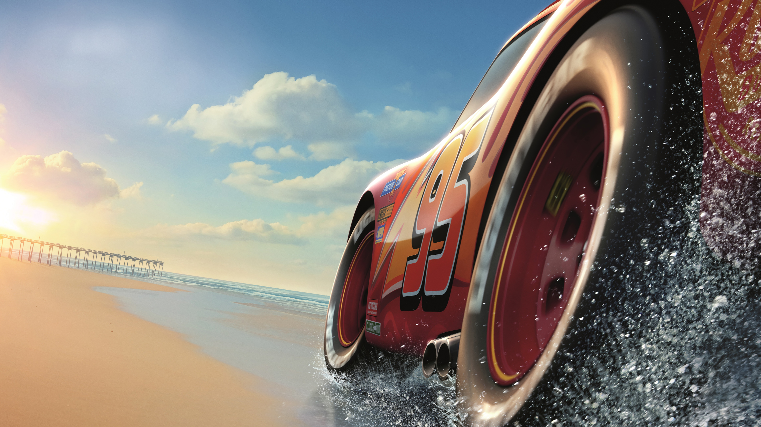
5. Heuristics Evaluation and Recommendations

Slide 13
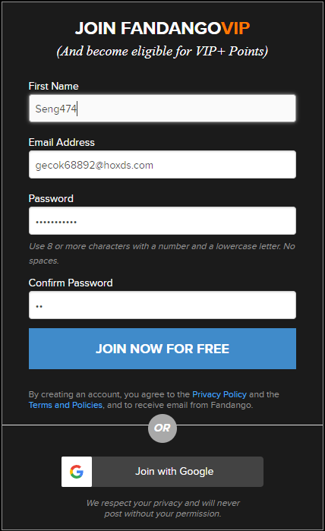
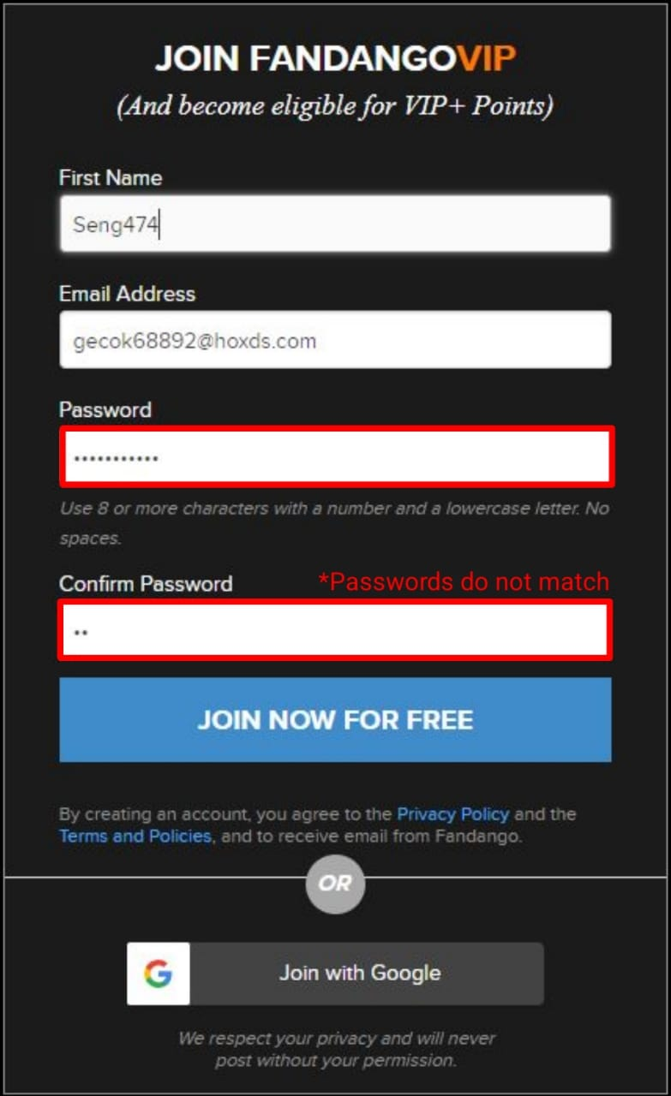
The system allows the user to click on the register button even the passwords do not match when the user is register into the system. Then, the system displays the error message to the user. Instead, when the passwords entered do not match each other, the system can immediately alert the user by drawing the password box with a red line. In this way, the user can find out without registration that the password does not match.
*Problem
Recommendation
4

Slide 14

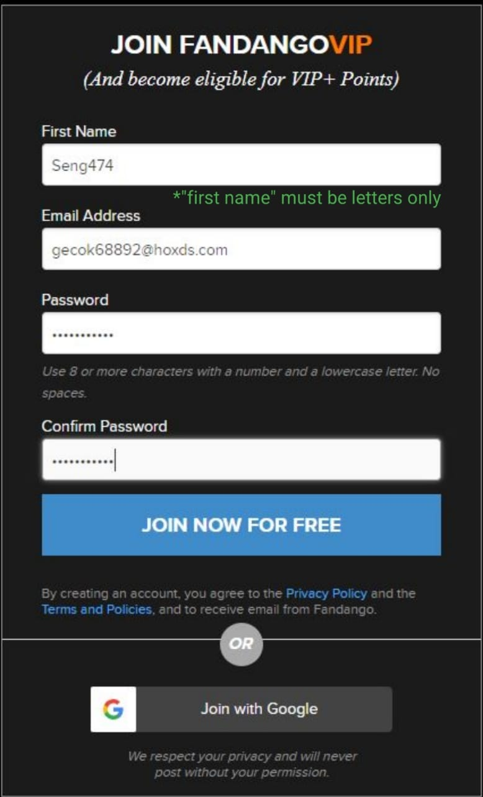
The system does not tell to the user that there is any restriction that enters the "first name". So the user thinks she/he can register into the system with the "first name" she/he wants. But when the user clicks on the register button, the system tells the user that the name should only use letters. This causes a bad experience for the user. To correct this, the user must be told which characters must be entered where the " first name" was taken.
*Problem
Recommendation
4

Slide 15
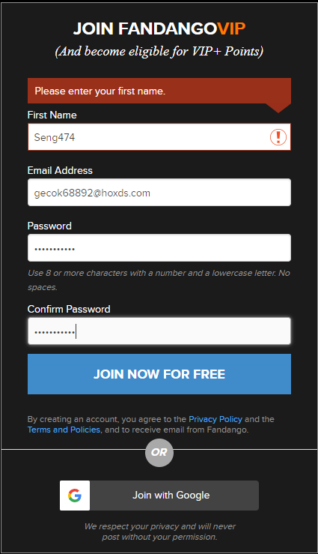
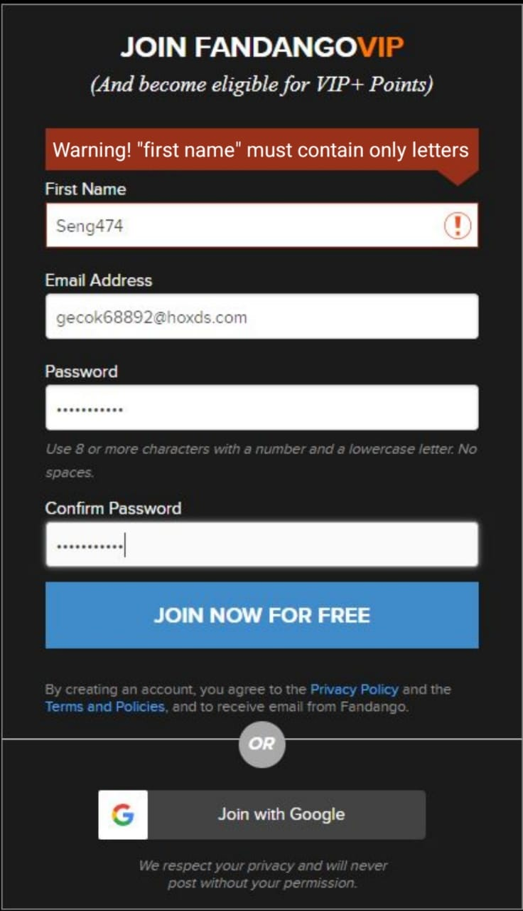
The error message that occurs when the user makes a mistake in the "first name" section when register into the system is not descriptive. The error message does not contain enough information about the user's error. The error message only warns the user that she/he has never entered a name, although she/he has entered a letter that should not be in the "first name".
*Problem
Recommendation
7

Slide 16
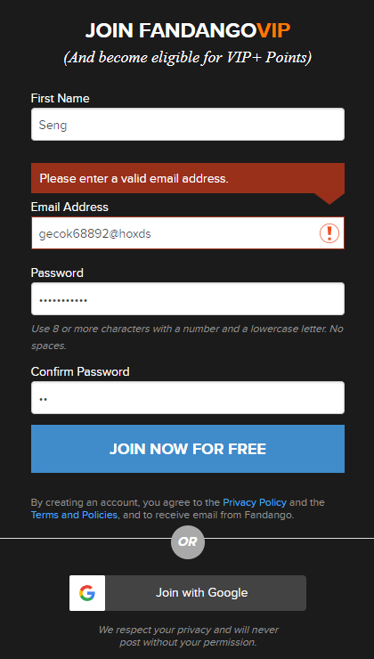
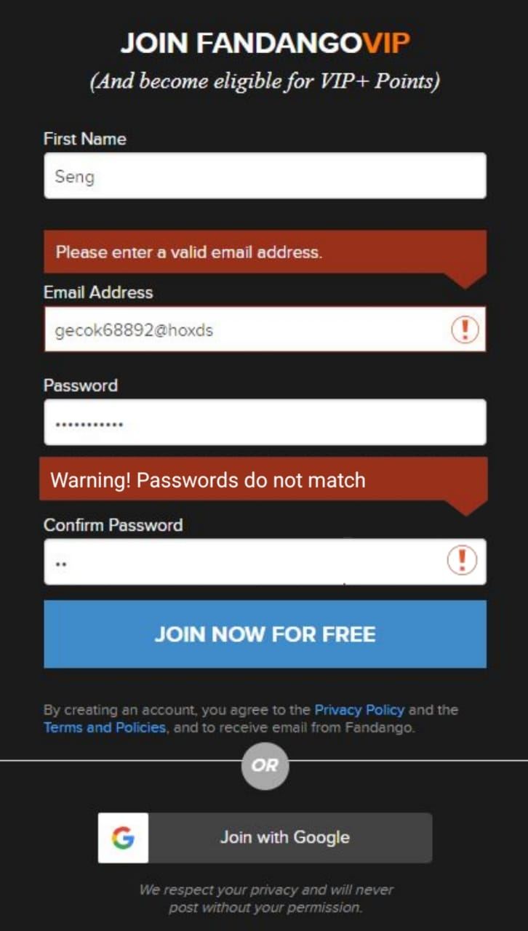
The system shows the user only one error, although the user has made multiple errors during the same operation while registering on the registration screen. Other errors are shown after the first error is corrected. If all errors are displayed by the system at the same time, the user will be better informed.
Recommendation
*Problem
7

Slide 17
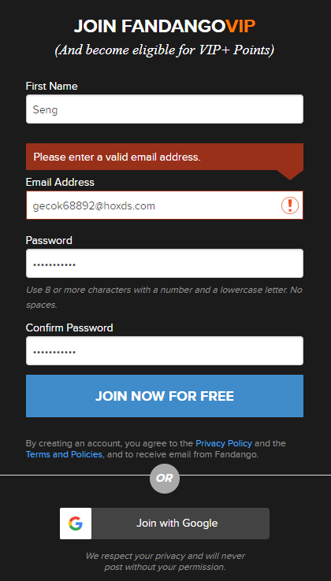
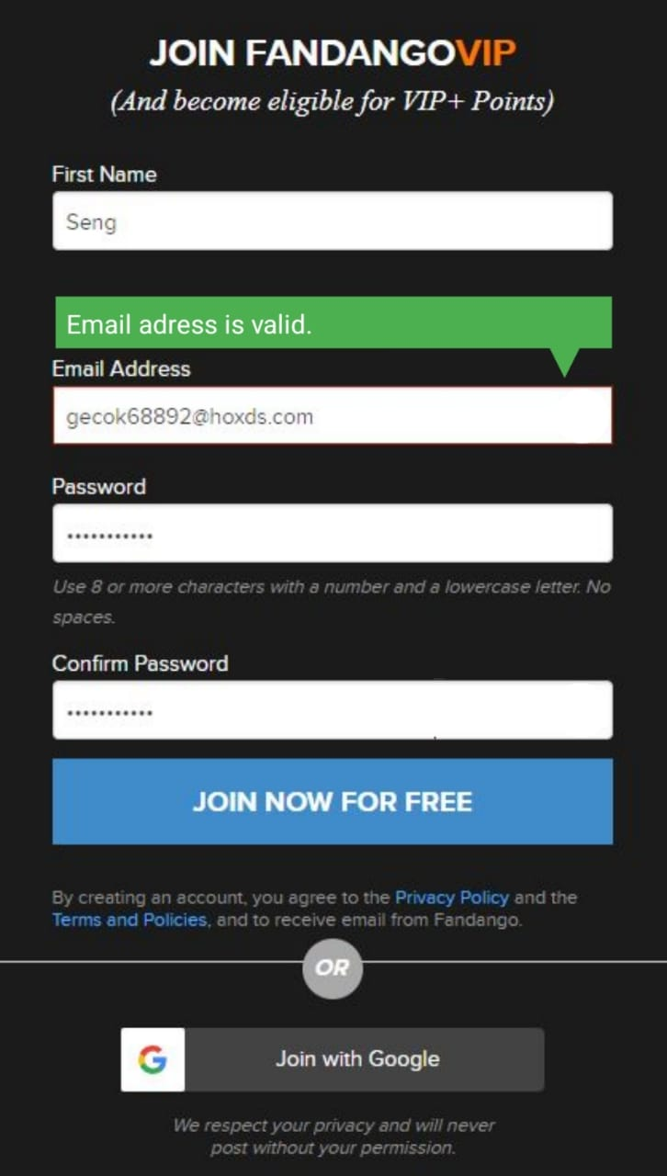
Even if the user corrects errors, error messages continue to appear on the screen until the user takes the next step. This causes confusion for the user. Instead, warning messages should disappear on the screen when the error is corrected. The system should notify the user that the error has been corrected.
*Problem
Recommendation
14

Slide 18
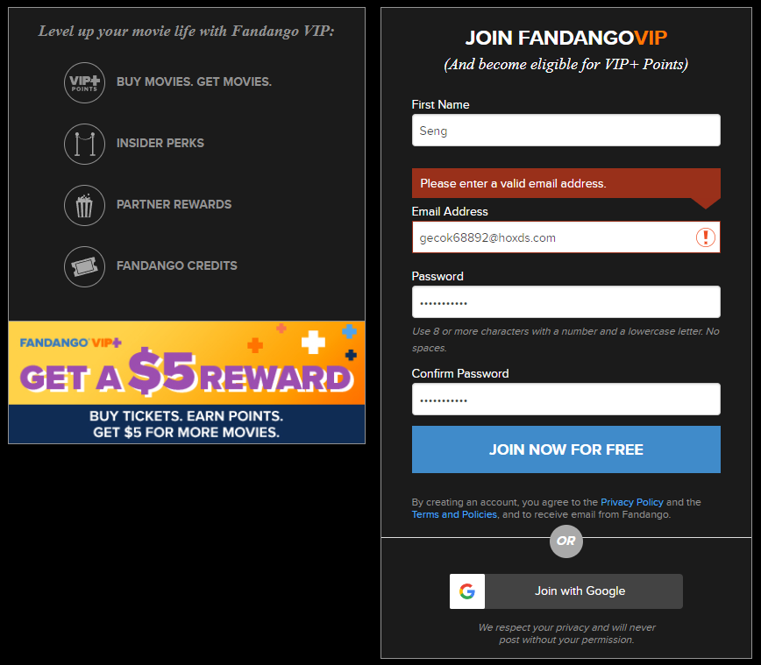
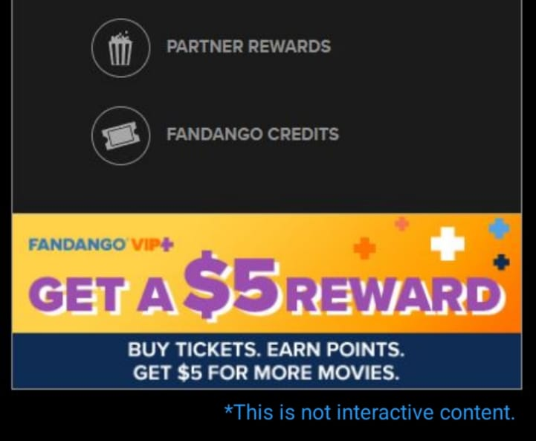
The visuals next to the register section make it feel like they're a button. Because similar pictures are clickable inside the website. This situation confuses the user and restricts the user's freedom. This situation can be told by changing the images or by a notification message.
*Problem
Recommendation
11

Slide 19
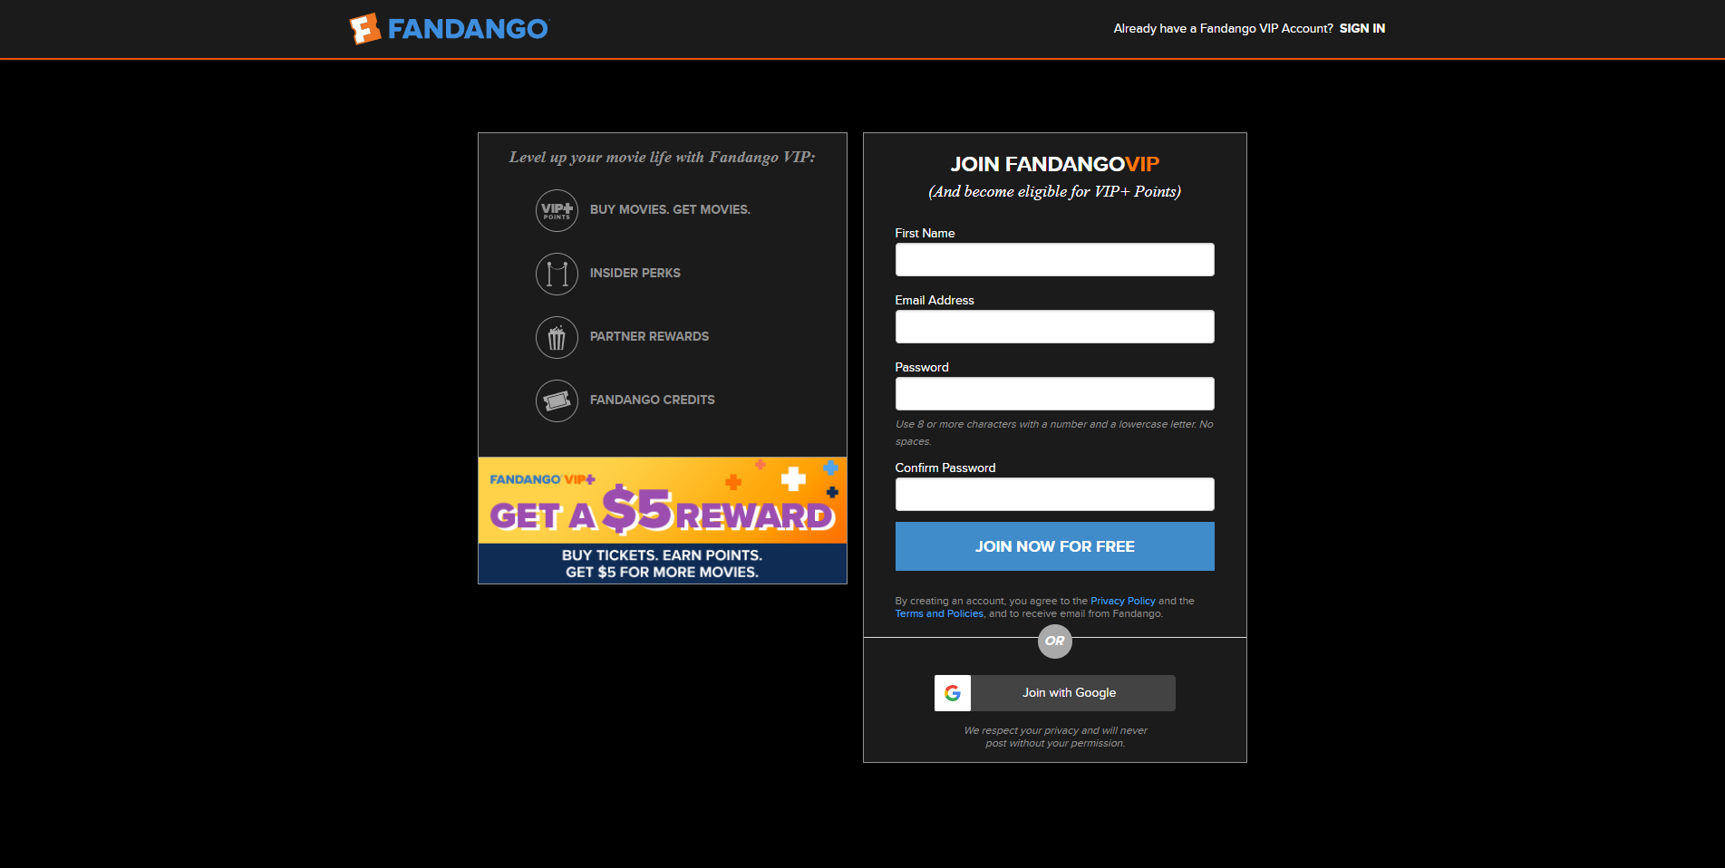
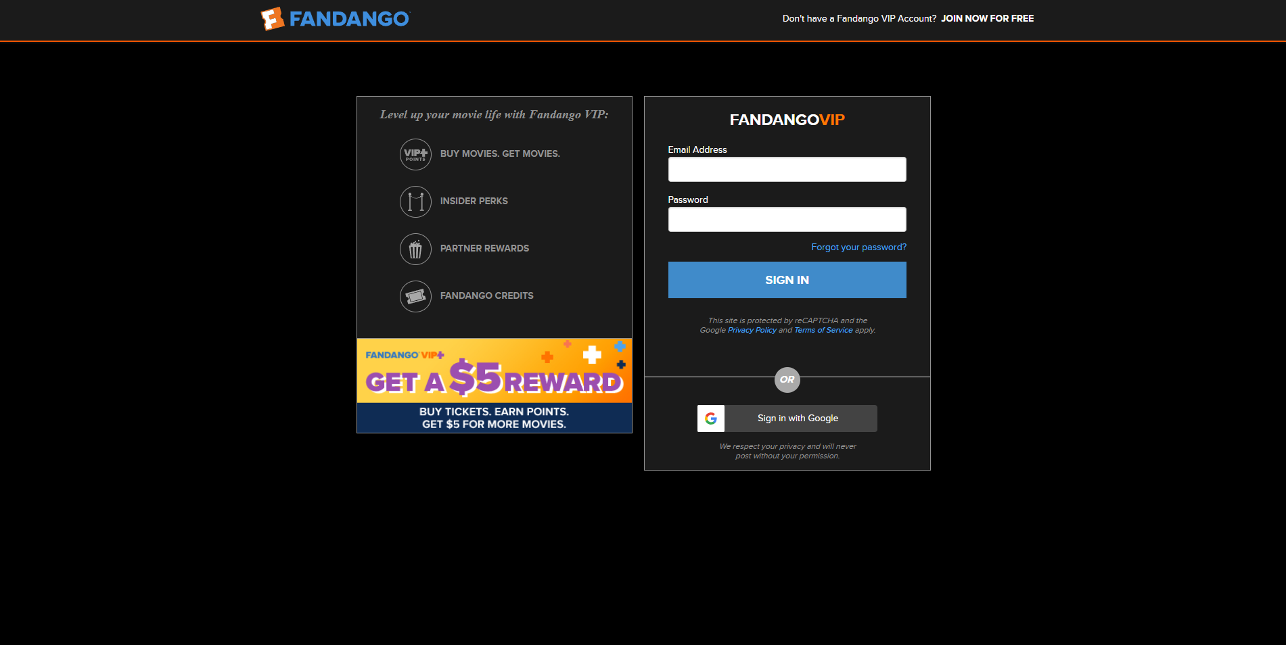
The interfaces of the Sign-In and Sign-Up screens are incorrectly designed. This page is not user-friendly due to incorrect color palette selection, insufficient icon and incorrect information. This situation can be corrected by using modern designs, colors and icons.
*Problem
*Problem
6

Slide 20
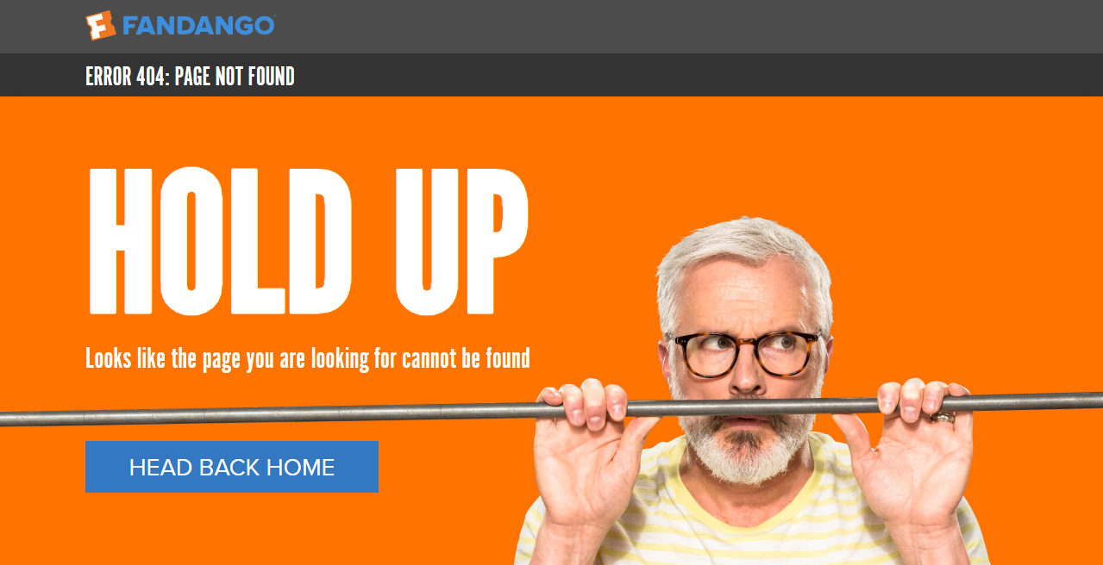
After the user has created a new account, she/he sometimes fails to log in when she/he wants to log in. In such cases, the account is opened after 2-3 consecutive attempts. In addition, the system does not explain clearly the cause of this error. This situation is very uncomfortable. This should be corrected quickly by checking the codes of the website.
*Problem
8
18

Slide 21
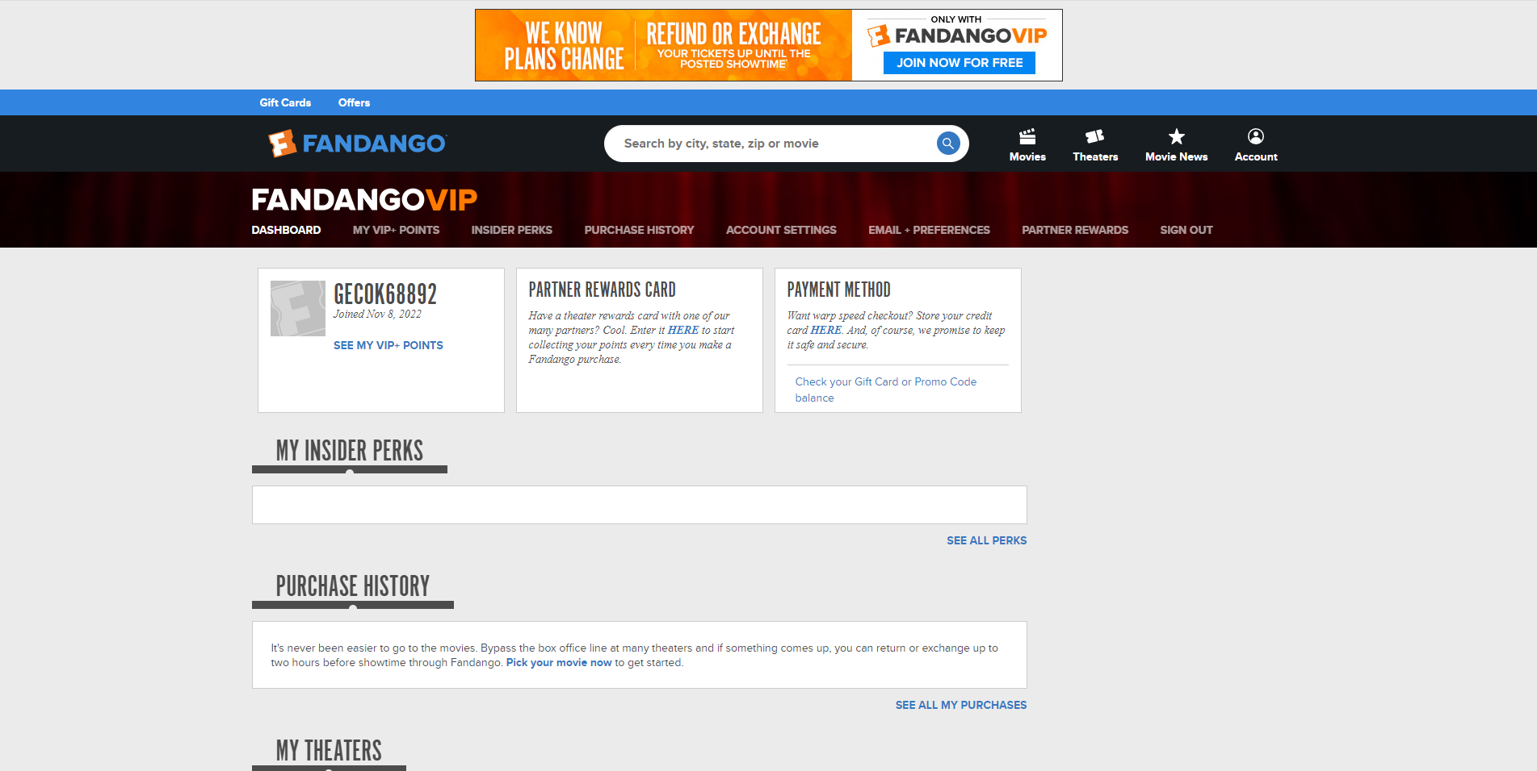
The design and content of the account page contain too much information, so it can confuse users. The information contained on this page is not clearly and grouped. All information that concerns the user is disorganized. This makes it difficult for the user to find the information she/he wants. Today's trends need to be analyzed and redesigned. A more modern, simple and understandable interface can be prepared.
*Problem
6
13
17

Slide 22
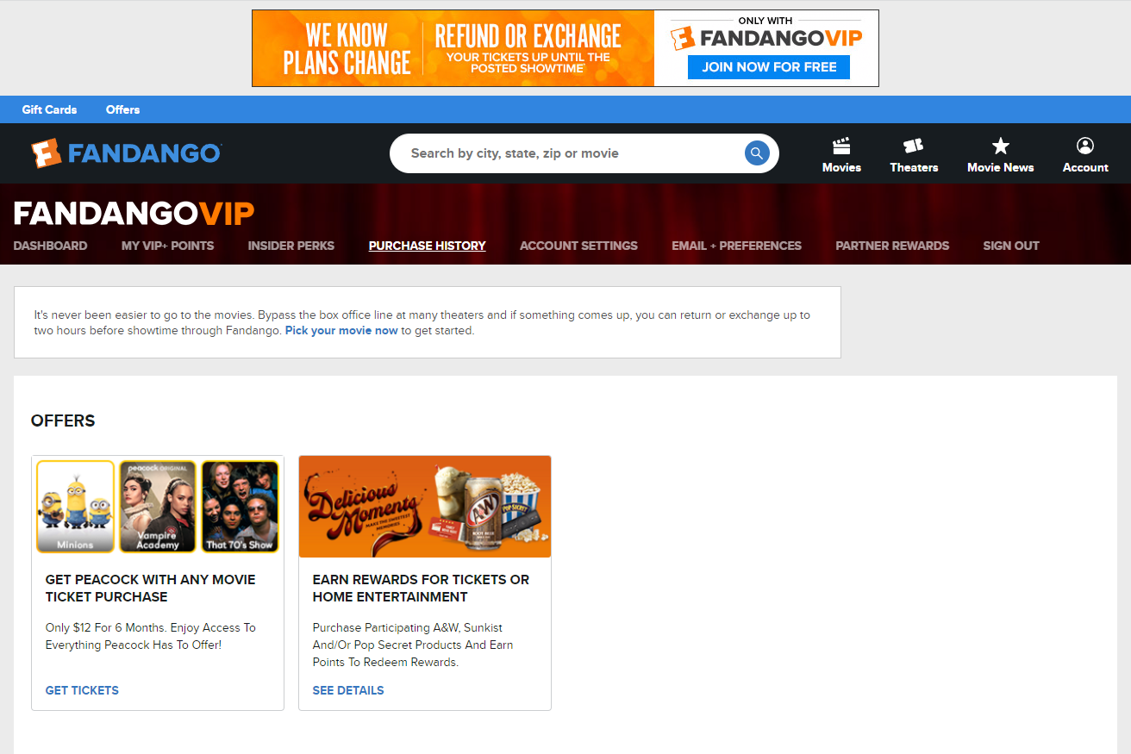
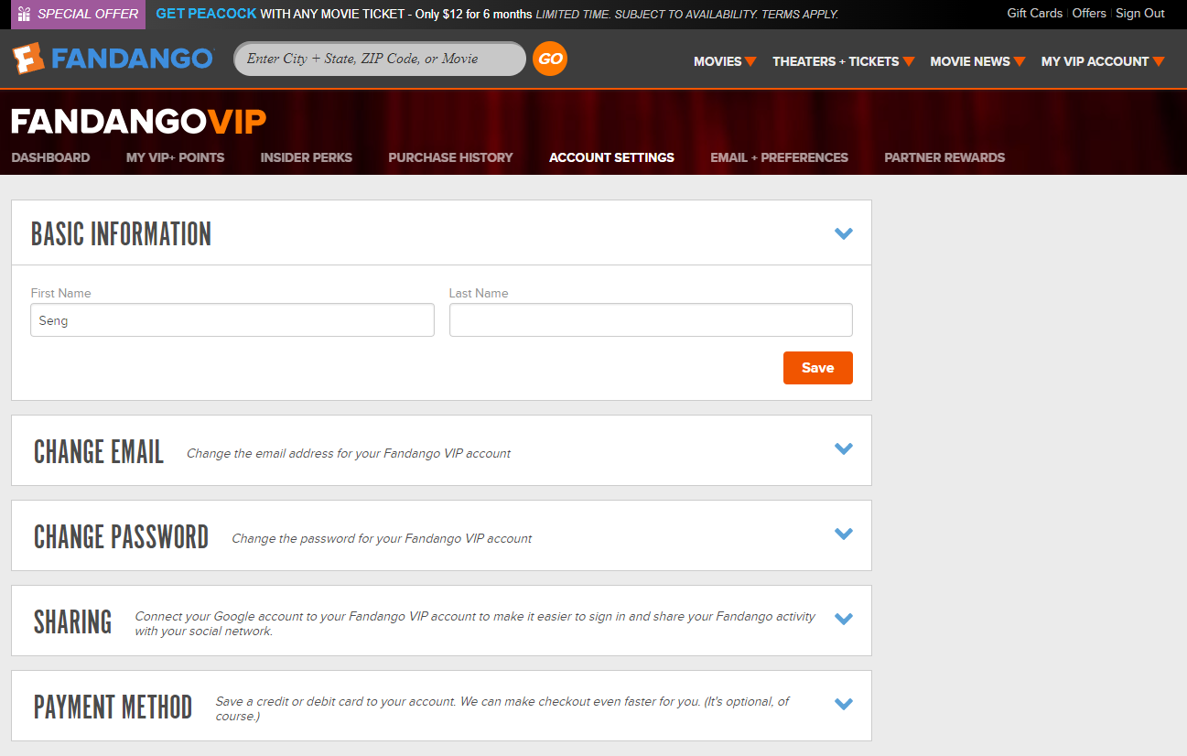
After the user opens "account" page, the buttons for the "account page" appear. When the user clicks these buttons, the information under buttons changes. The biggest problem with these buttons is "account settings" button. When the user clicks on this button, the system opens page that is a different interface from the original site, as icon, color, and design. This is an obstacle to the user's habit. It confuses the user. The page that this button opens should be updated according to the original site. So it can adapt to the website, like other pages.
3
12

Slide 23
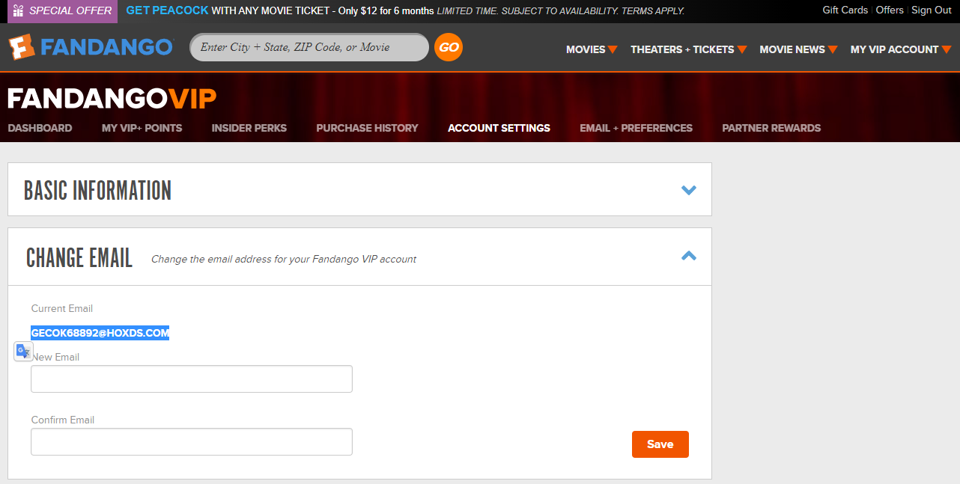
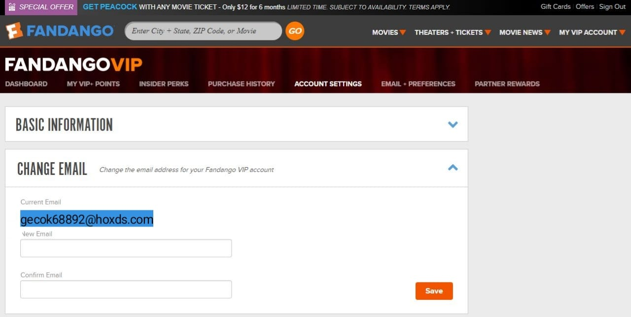
The account details section shows all characters of the user's email address in uppercase letters. This may cause confusion about the user's email address. The format for displaying the email address must match the format of the email address that the user uses when registering.
Recommendation
*Problem
2

Slide 24
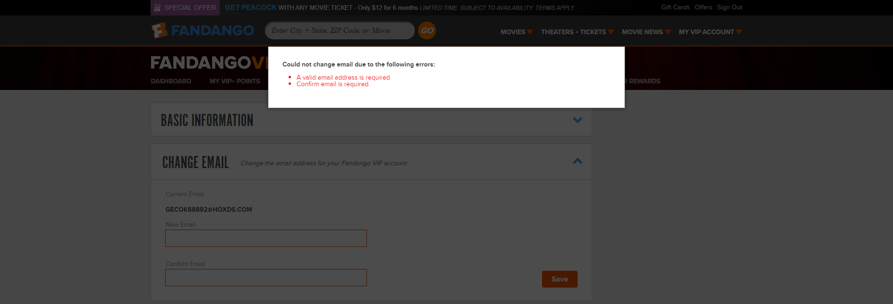
When the user makes any changes to the account details, the warning messages sent by the system appear instantly on the screen. The message is lost quickly without the opportunity to read warning messages. The duration of the warning message on the screen should be extended or warning messages should be displayed at the point of the error. The design of the warning message must be changed.
*Problem
4
7
12

Slide 25
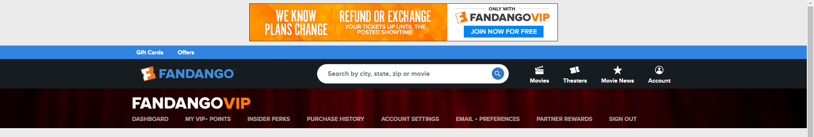
When the user clicks the "e-mail preference" button from the buttons on "account" page, there are no symptoms. When the "e-mail preference" button is active, it does not display any color changes or shape changes shown like the other buttons. The codes of this button must be corrected.
*Problem
Recommendation
14

Slide 26
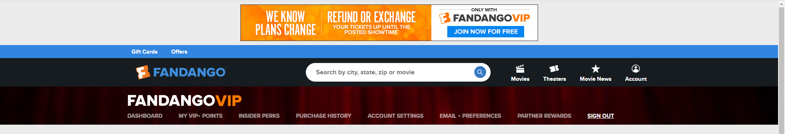
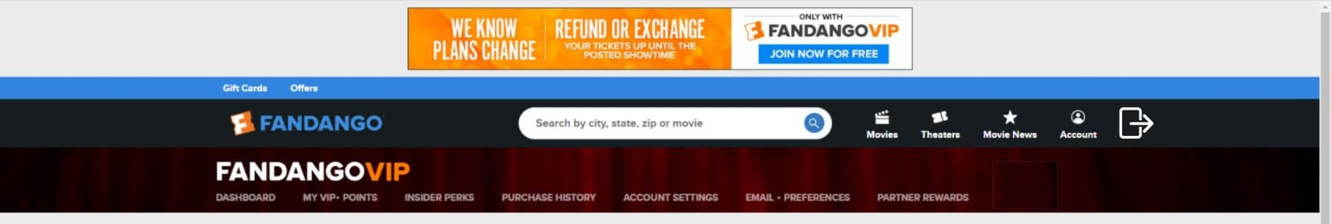
The "Sign Out" button on the "account" page is incorrectly designed as color, format and location. This button is very similar to the buttons on the side as color, format and location. This can cause the user to think of this button as other buttons and confuse the user. Because, when the user clicks on this button, a new page does not open like when you click on other buttons, the system log out of your account. The design and position of the Sign-Out button must be changed.
*Problem
Recommendation
3
11
15

Slide 27
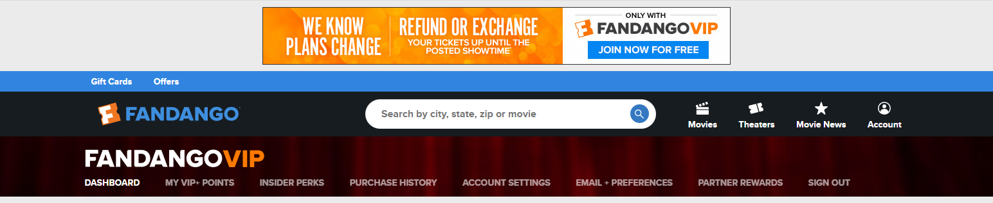
Although the user does not have any vip membership in the system, there is the phrase "FANDANGOVIP" in the upper left of the account page. This confuses the user and makes the user think she/he is a vip member. Only vip members should have the word "FANDANGOVIP" on their account page.
*Problem
Recommendation
2

Slide 28
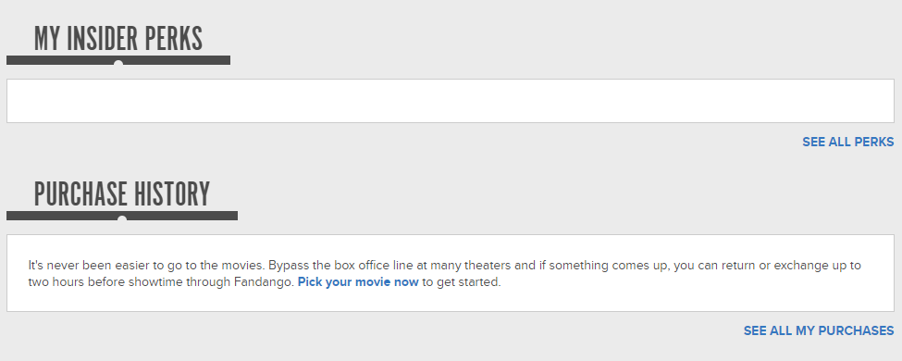
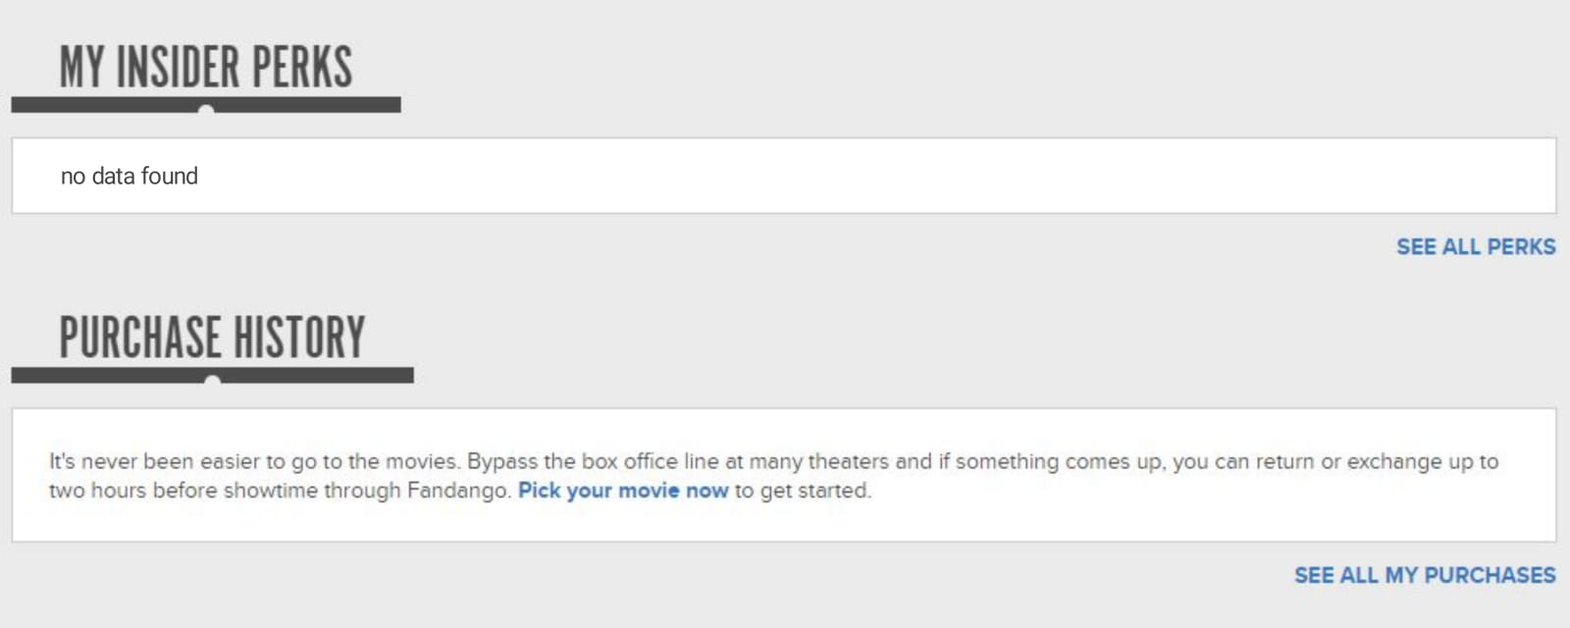
There is no message to inform the user when there is no content in the "My Insider Perks" section. This situation causes the user to think that the information is loaded and wait longer than necessary. The user is informed when there is no content in other parts of the website. Messages informing the user should be added for the "My Insider Perks" section.
*Problem
Recommendation
17

Slide 29
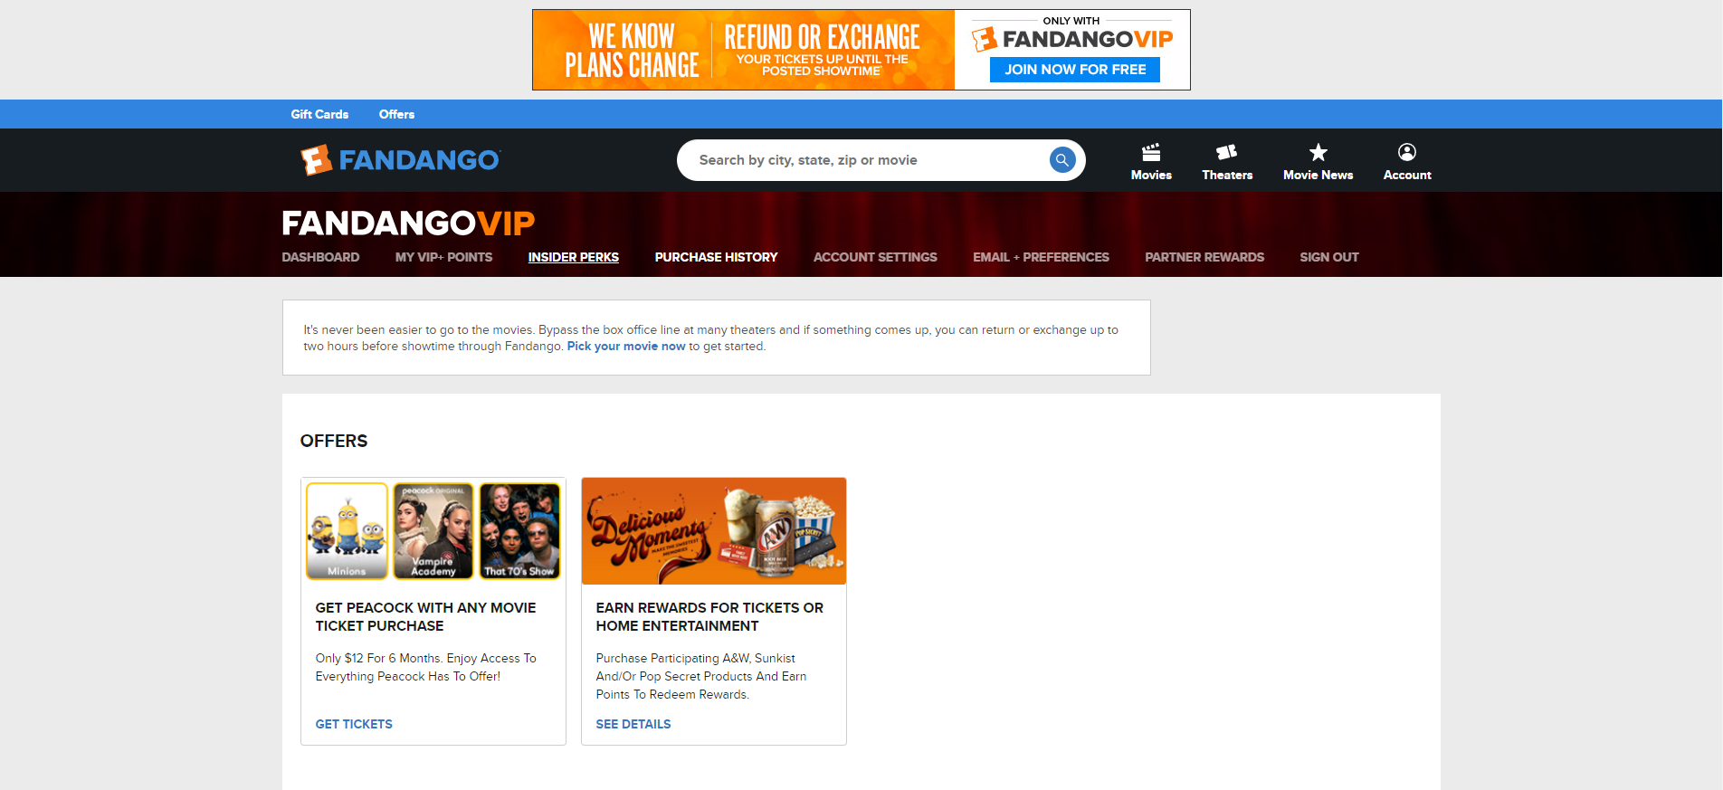
Although the "Insider Perks" and "Purchase History" pages are different pages, they are the same in content. This is a situation that can disturb the user. The contents of these pages should be corrected.
*Problem
2

Slide 30
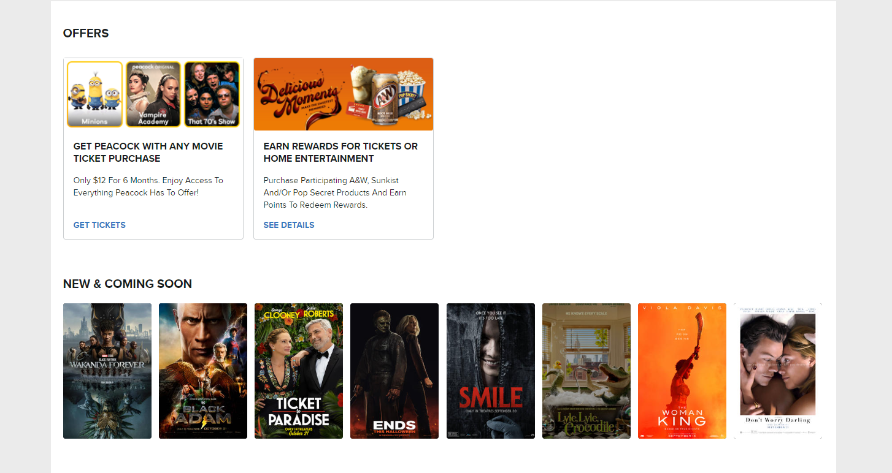
The same information is constantly displayed at the bottom of all pages of the "account" section of the website. This information, which is not related to the account and bothers the user, should be removed from the "account" section.
2
17
*Problem

Slide 31
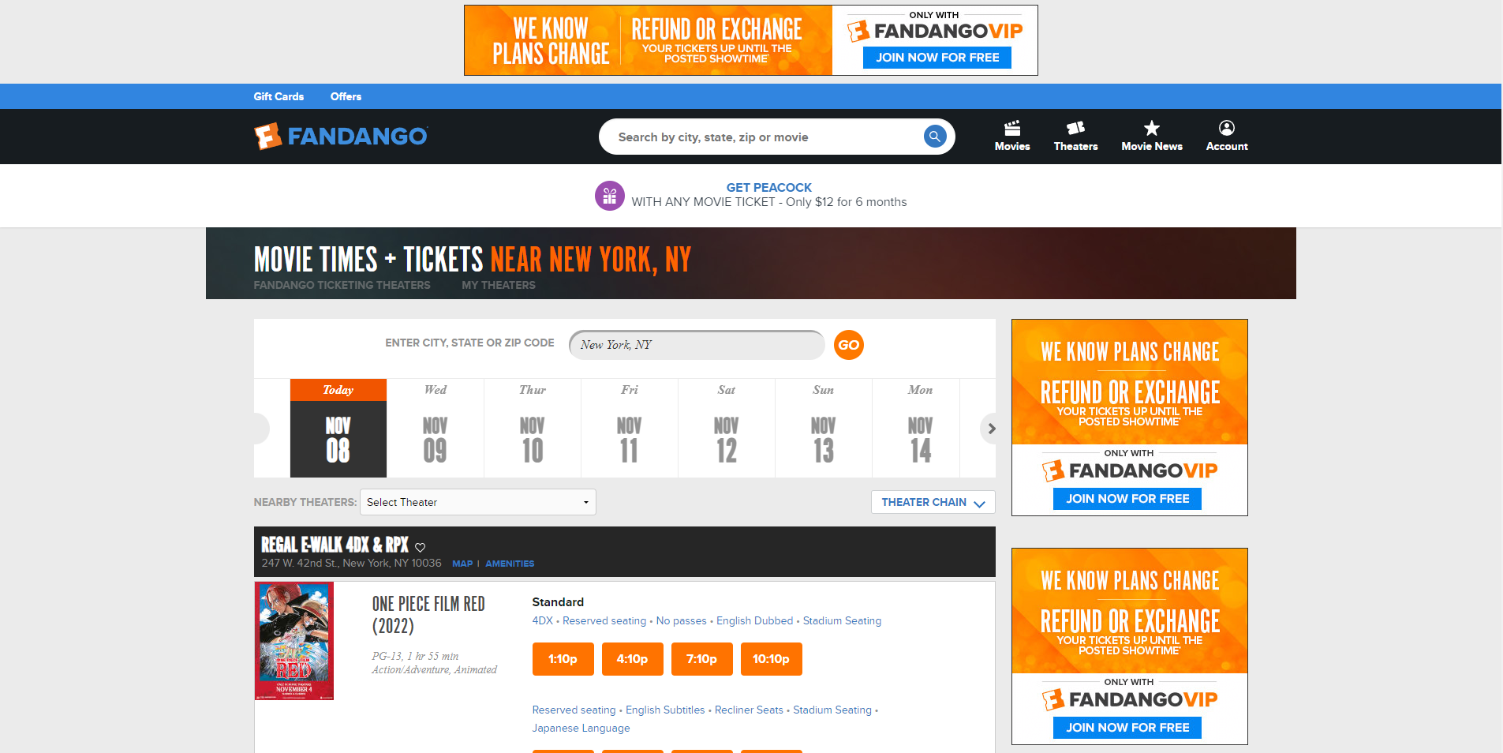
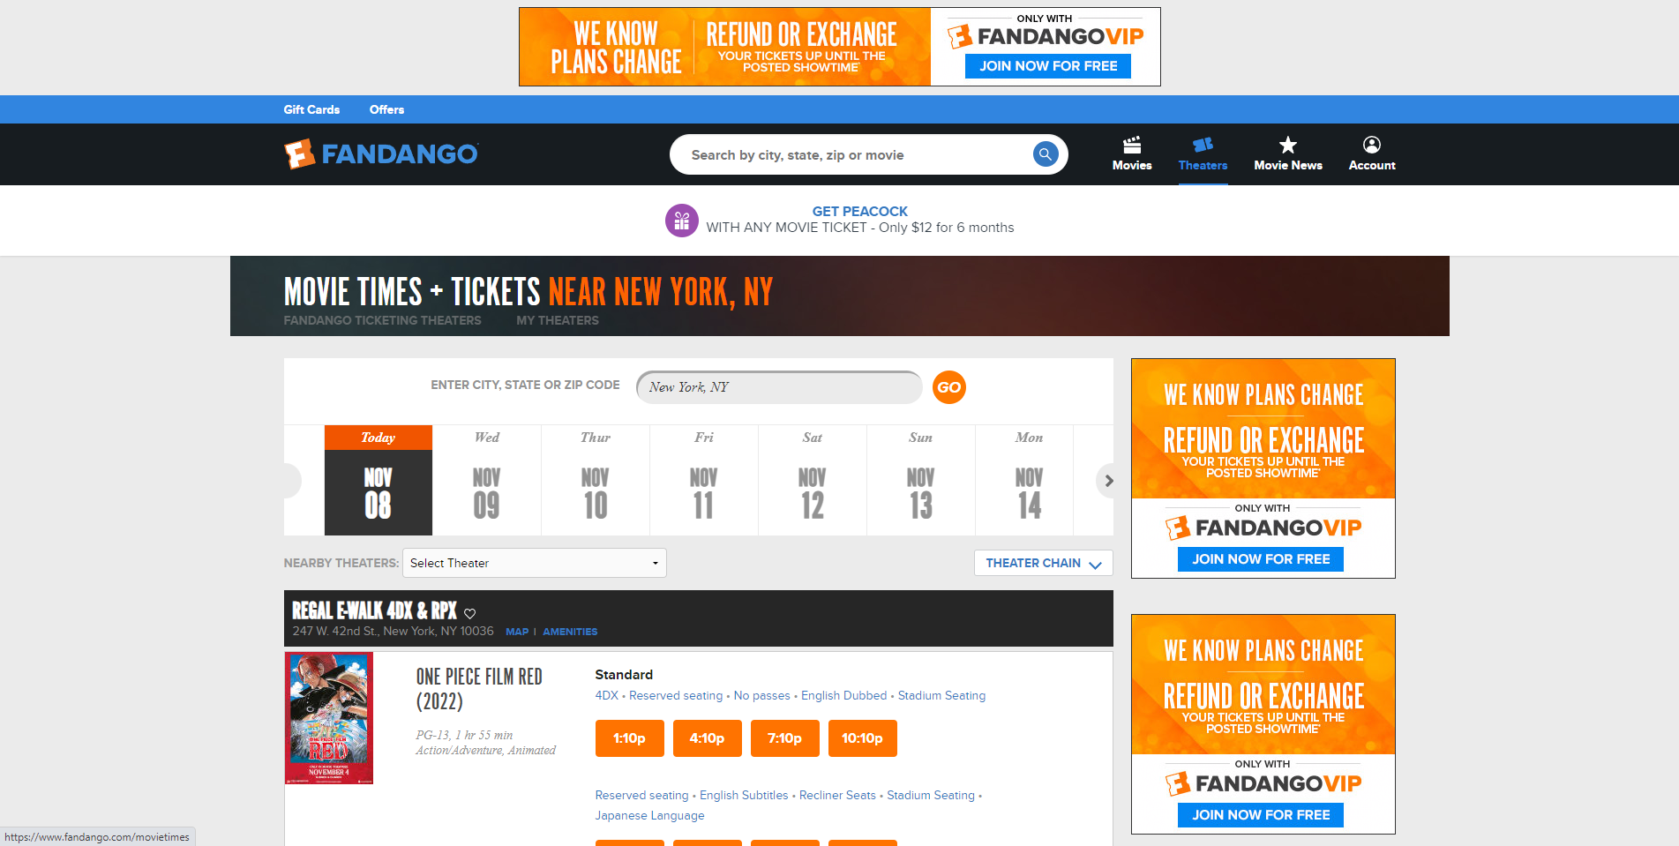
It is not clear which of the main buttons at the top of the website is active and showing content. Only when the user clicks on any of these buttons, the color changes and then turns into the same color as the other buttons. This causes confusion the user about which page is on. A feature should be added to distinguish the button whose content is displayed on the screen from other buttons.
*Problem
Recommendation
11
14

Slide 32
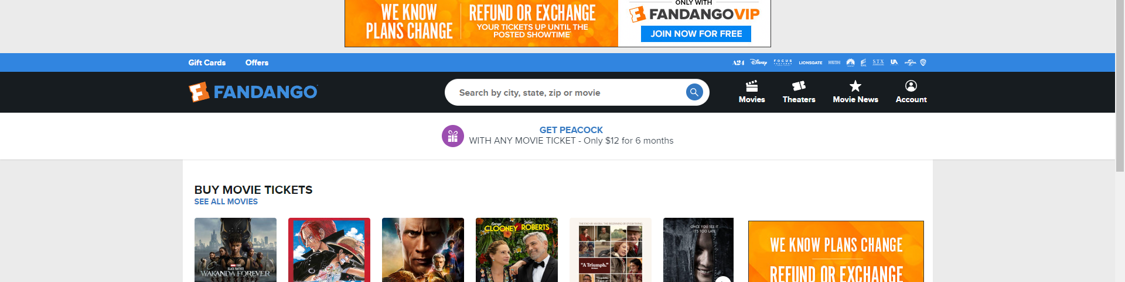
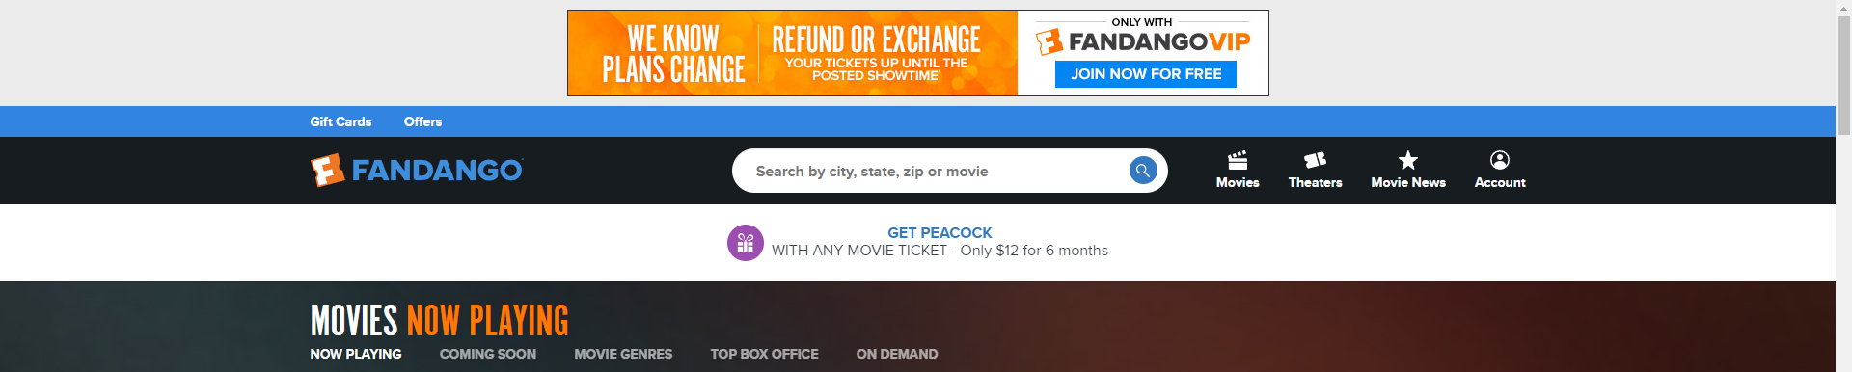
There are the logos of the film companies on the "Main Page" of the website .But, there are not found on the other pages. This situation disrupts the compatibility of the website. The logos of these film companies should either be placed on all pages or removed from the main page.
*Problem
13

Slide 33


The information of the brand, which looks like an advertisement on almost every page of the website, should be corrected. Because it looks like an advertisement because of its design. This confuses the user. The design of this part should be redesigned.
*Problem
*Problem
*Problem
11

Slide 34

Some of the contents on the main page of the website do not have buttons that allow the user to move the contents. This situation limits the freedom of the user. This situation disrupts the compatibility of the website. Buttons should be added to every such content.
3
13
*Problem

Slide 35


The website does not support different screen sizes. Some pages of the website are not dynamic.
18
*Problem

Slide 36


In some parts of the website, films are shown with their names and posters, and in some parts only with their posters. This situation disrupts the compatibility of the website. As a solution, only one way should be chosen to exhibit the films.
*Problem
13

Slide 37


The newly released movies and coming soon movies are listed in the same list on the website. This causes confusion for the user. Above or below each movie, it should be stated that the movie is new or will be released soon.
*Problem
Recommendation
2
17

Slide 38

The filtering feature of the website should be more user friendly. More filtering features should be offered to the user. More filtering features should be added to the website and its design should be updated.
*Problem
5
6

Slide 39


After the user has filtered the movies, she/he cannot remove them. So, the user has to refresh the page to see all the movies without filter. This situation limits the freedom of the user. Also, the user cannot select multiple categories at the same time. The filtering feature of the website needs to be updated.
*Problem
10

Slide 40


When the system does not find any movies as a result of the filtering made by the user, it does not show the user a notification message. It just shows a blank page. So, the user is also waiting for the page to load. This causes the user to waste time. As a solution, the system should inform the user when a suitable movie is not found as a result of the user's filtering.
*Problem
Recommendation
17

Slide 41

The buttons that switch between movies on the website consist of numbers. Both the color and size of these buttons are wrong. The color of the buttons makes it difficult to see the buttons. The size of the buttons makes it difficult to touch. Also, "More" is written on the buttons used to switch to the page of other movies on the website. It is more correct to write "next" on these buttons. These buttons should be updated.
*Problem
*Problem
6
11
12
16

Slide 42

On the website where the movie genres are listed, some movie genres are listed as (genre + movie), while some movie genres are listed only as (genre). This situation disrupts the compatibility of the website. It may bother some users. As a solution, movie genres should be displayed in a single format.
*Problem
13

Slide 43


The "Top Box Office" button of the website opens the wrong page. While the "Top Box Office" button should open the page showing the top movies, it opens the main page of the website. This confuses the user. The "Top Box Office" button should be fixed.
*Problem
While the website's "On Demand" button should work like the other buttons next to it, it opens another website. This confuses the user. This button should be designed differently from other buttons.
*Problem
3
13
18

Slide 44


The buttons that allow switching between movies, features and pictures on the website are designed differently in each section. This situation disrupts the compatibility of the website. It causes the user to get used to the more difficult website. A single type of button should be preferred in each section.
*Problem
*Problem
*Problem
*Problem
13

Slide 45

Trailers of movies can be watched on the website. But the quality of the watched trailers cannot be changed. This situation limits the freedom of the user. The user should be given the right to change the quality while watching the trailers.
2
*Problem

Slide 46

The page on their website showing movie details was not user-friendly. On this page, pictures of the movies are available in small size and in cut form. Images should be larger and shown in full. It should be redesigned in a modern way.
*Problem
2
6

Slide 47


Tickets can be purchased for the movies that are currently in theaters on the website. But sometimes, when you click on the movie to buy a ticket, the day and time do not appear. When the user refreshes the page 2-3 times, the days and hours come. The problem causing this situation should be identified and resolved.
*Problem
18

Slide 48

Details of actors are shown on the website. But there is a part that has nothing to do with the actors. The "Trailer Coming Soon" part does not have any function. This situation disturbs the user. This part of the actor page should be removed.
*Problem
18

Slide 49



The website only supports one language(English). This situation creates difficulties for global users to understand to the website. More language support should be added.
The design of the website should be reviewed from the beginning. The errors that emerged as a result of the examination should be eliminated and the page design should be made in a modern, simple and stylish way in accordance with today's trend designs.

Slide 50


Thank You
Akın Kemal DOĞANGÜN
Ünal Ramazan DOĞANGÜN
doftdare company

